Slide 1
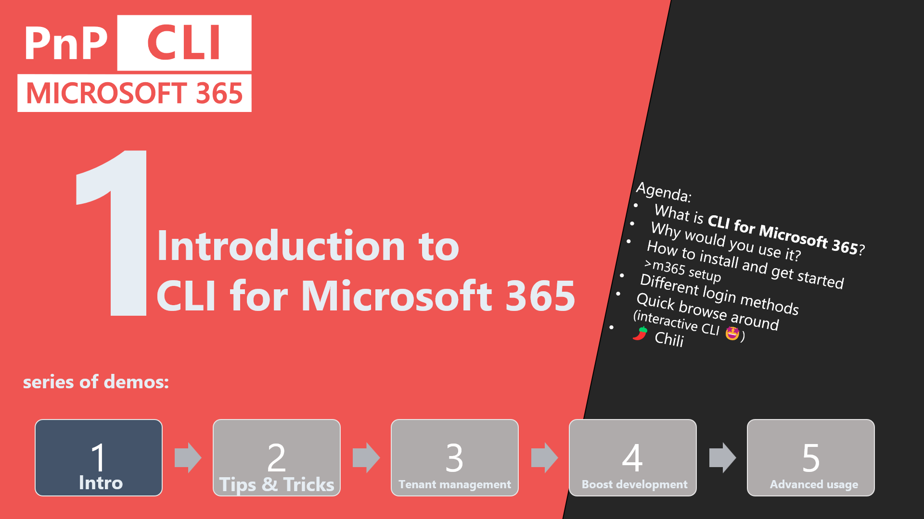

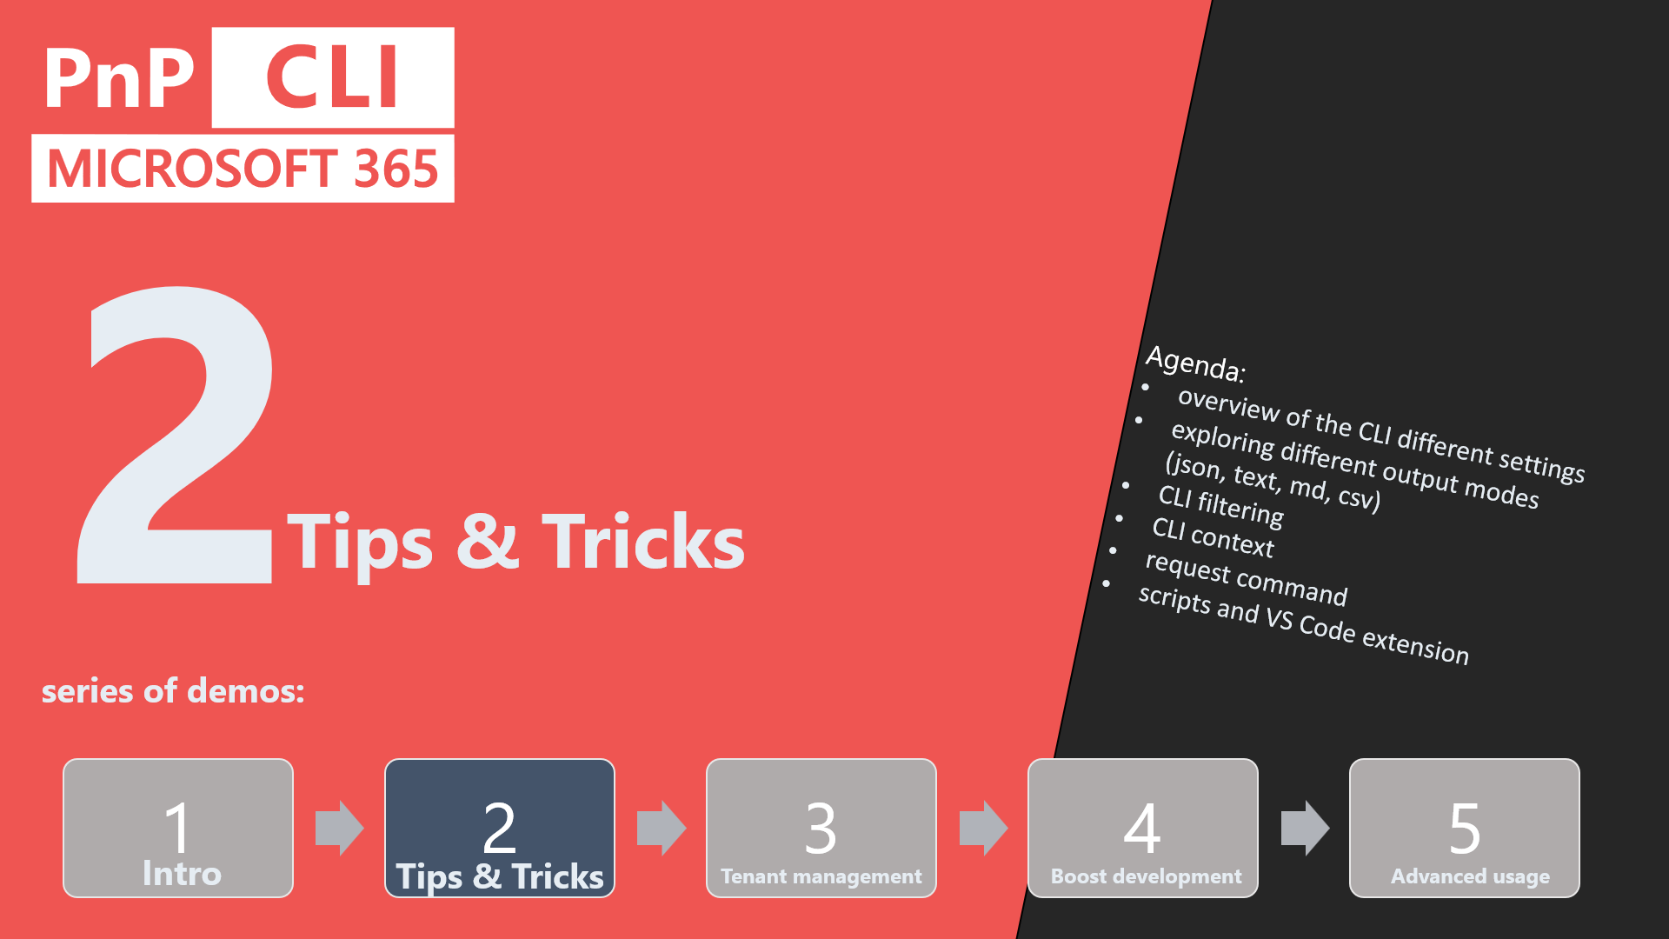
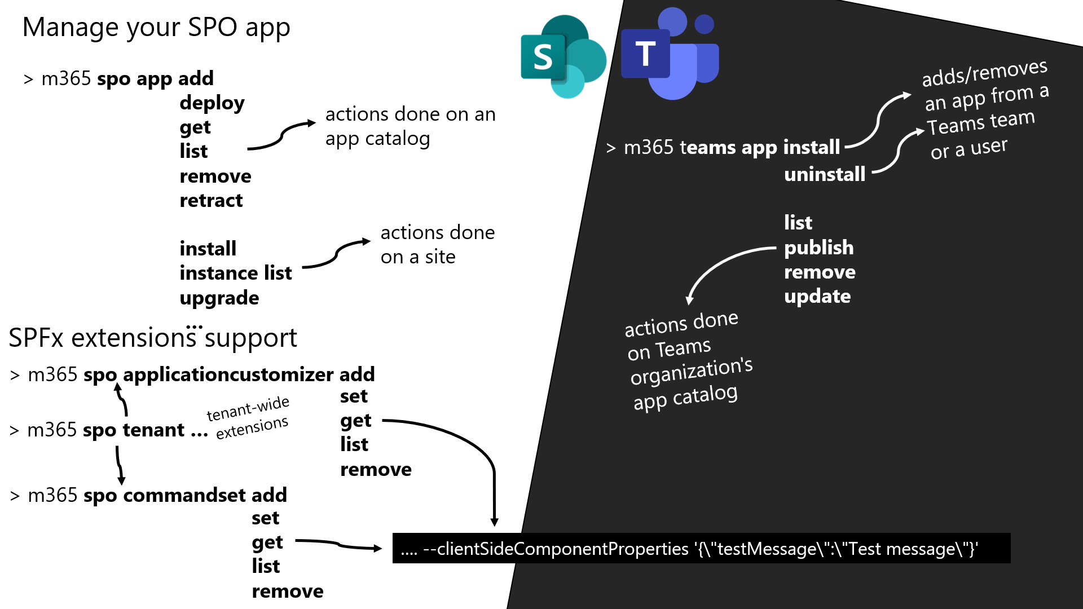
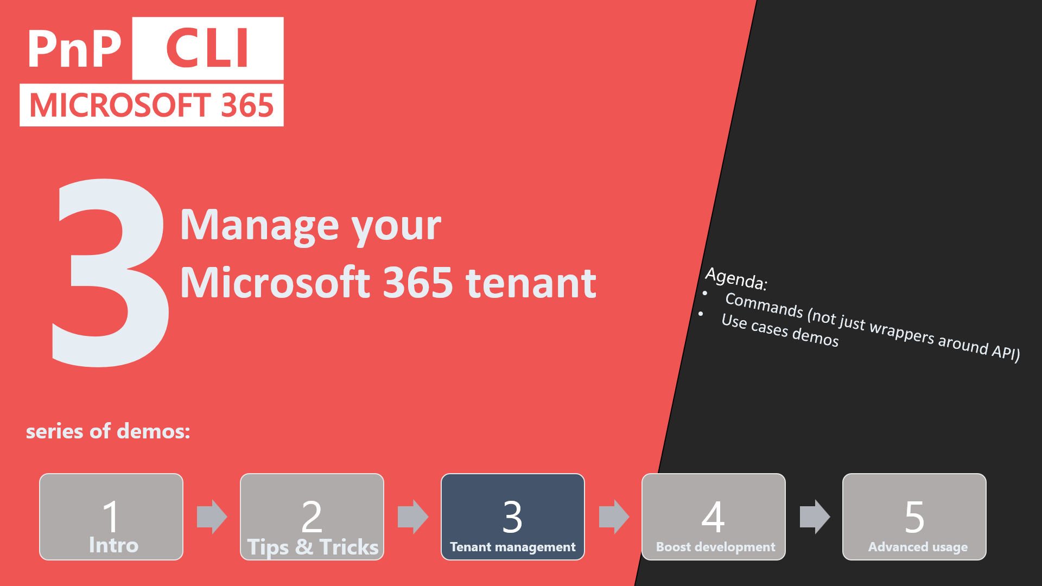
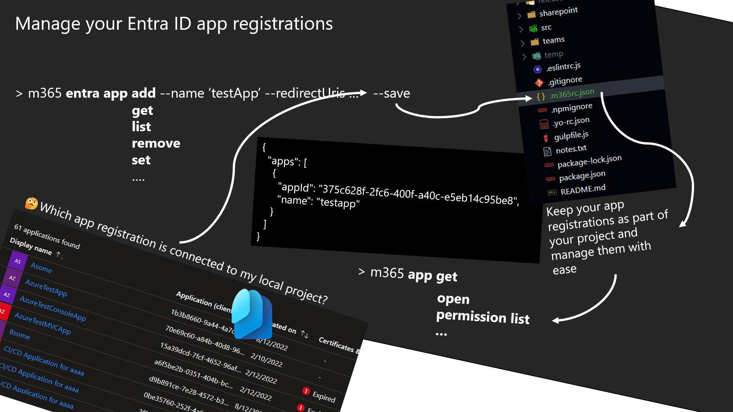
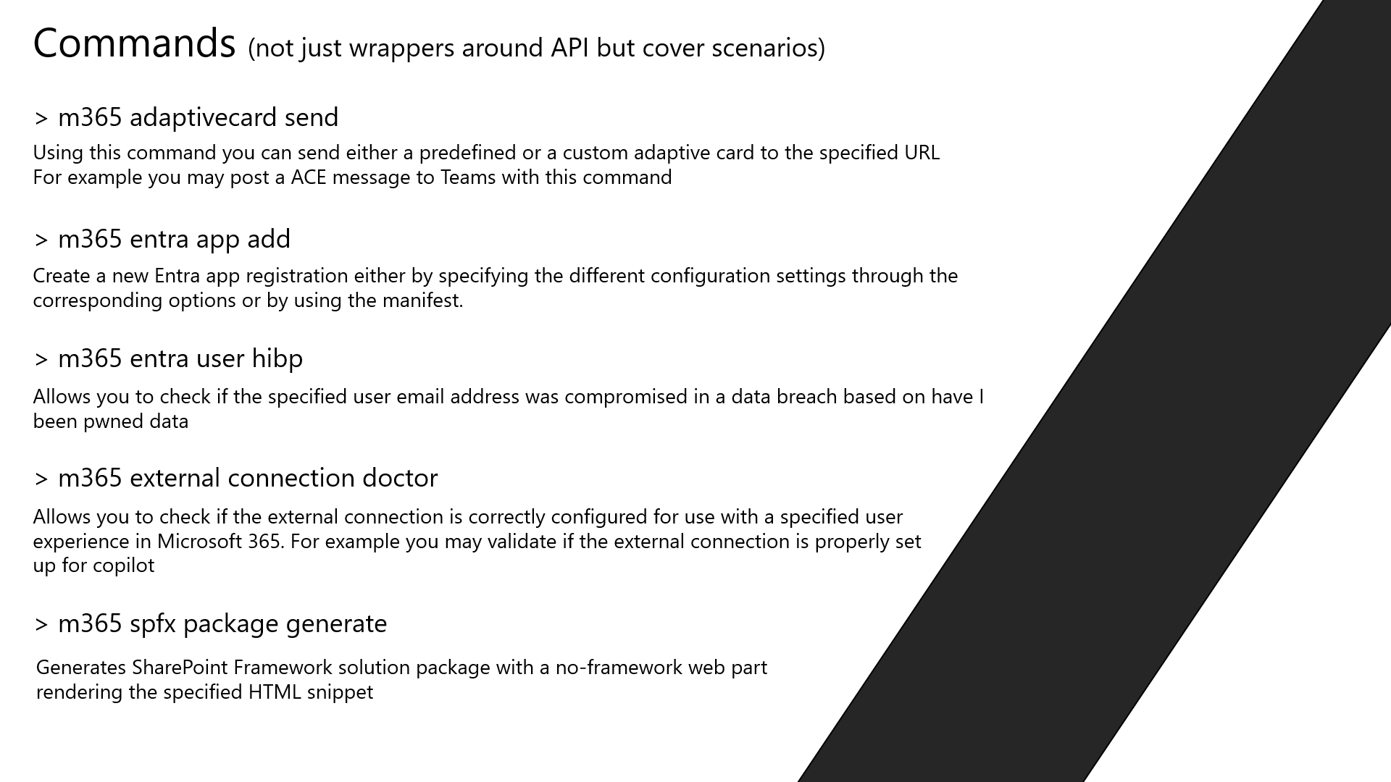
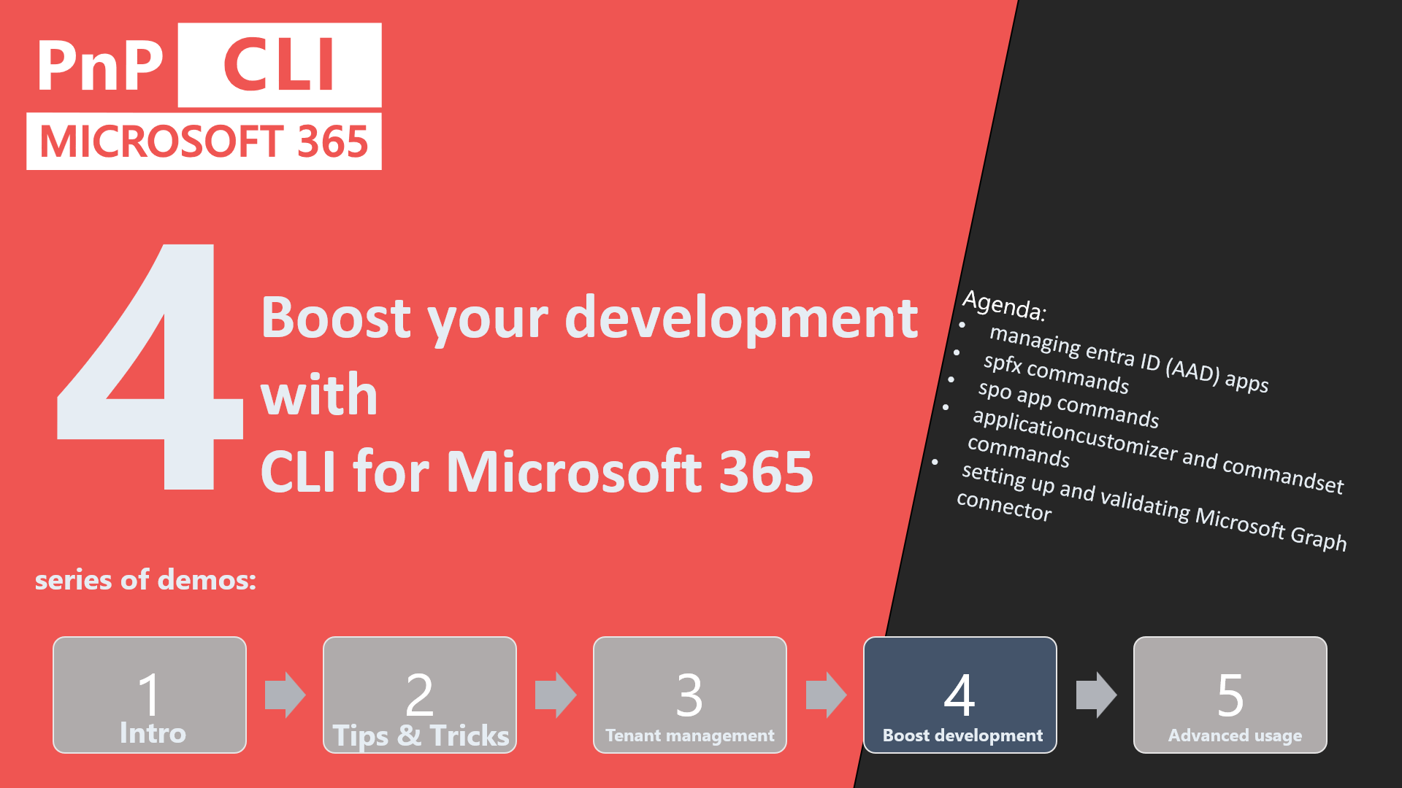
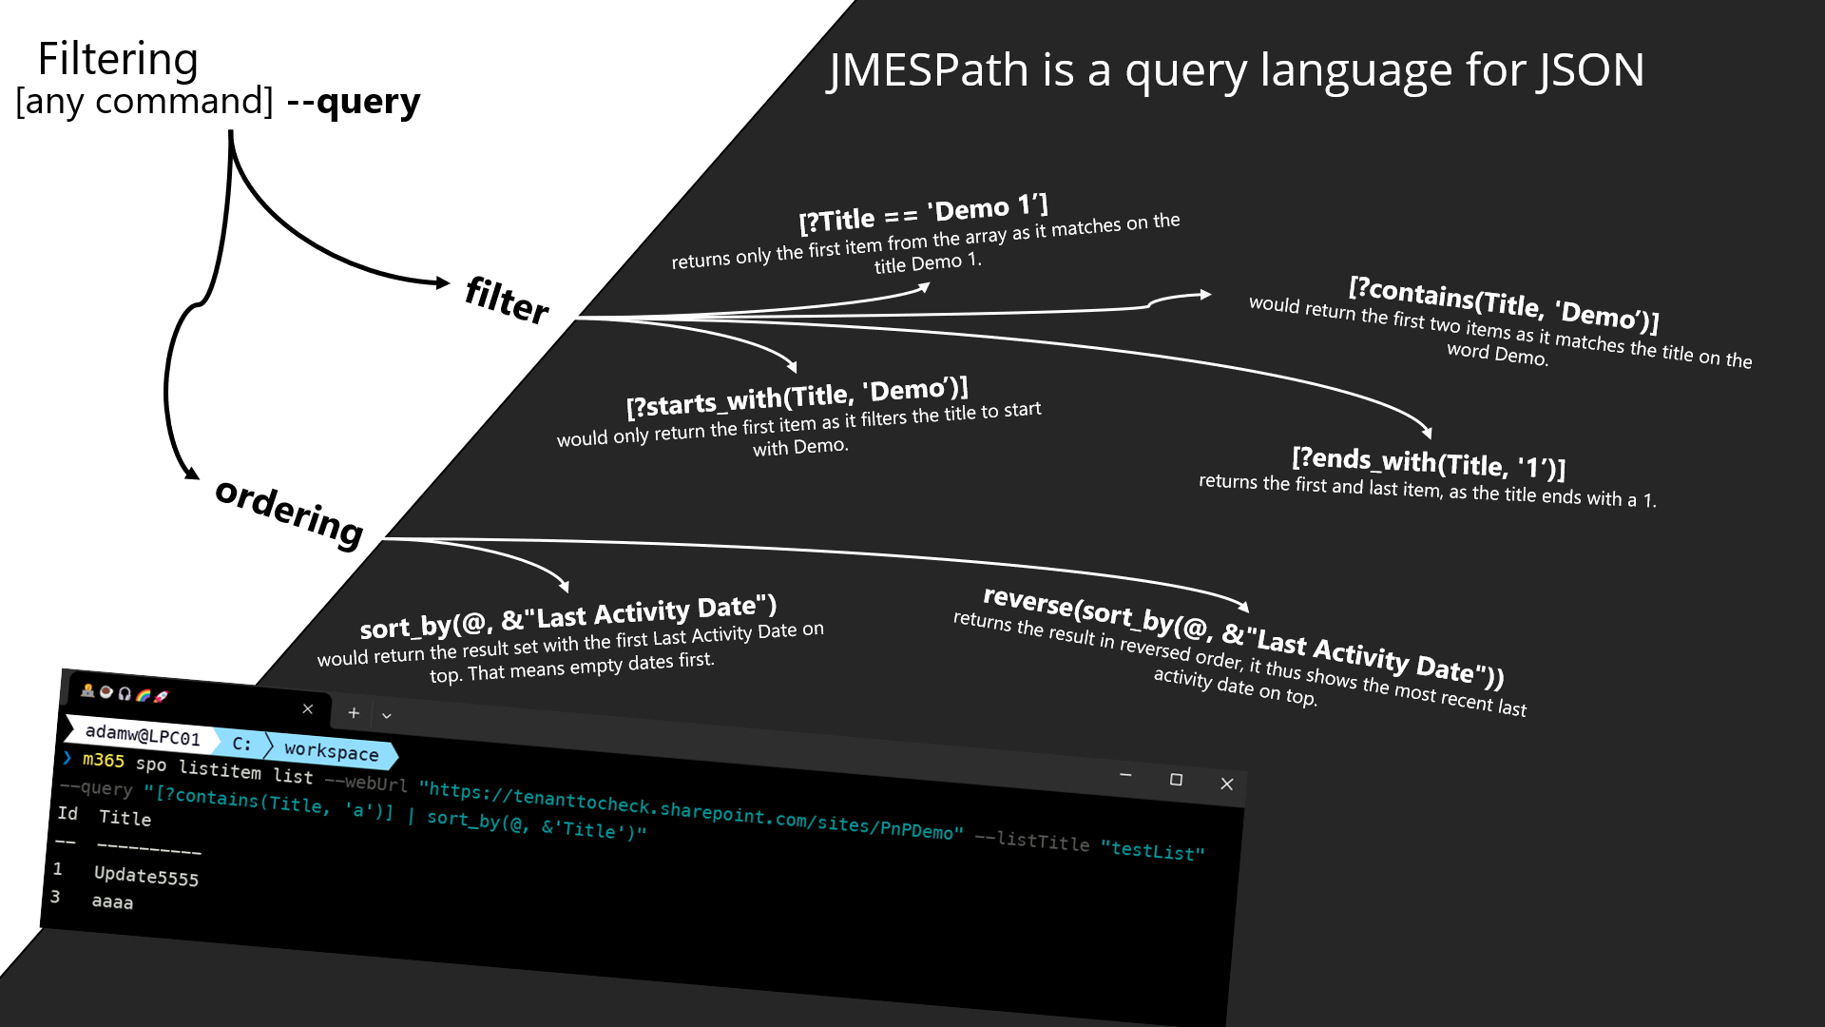
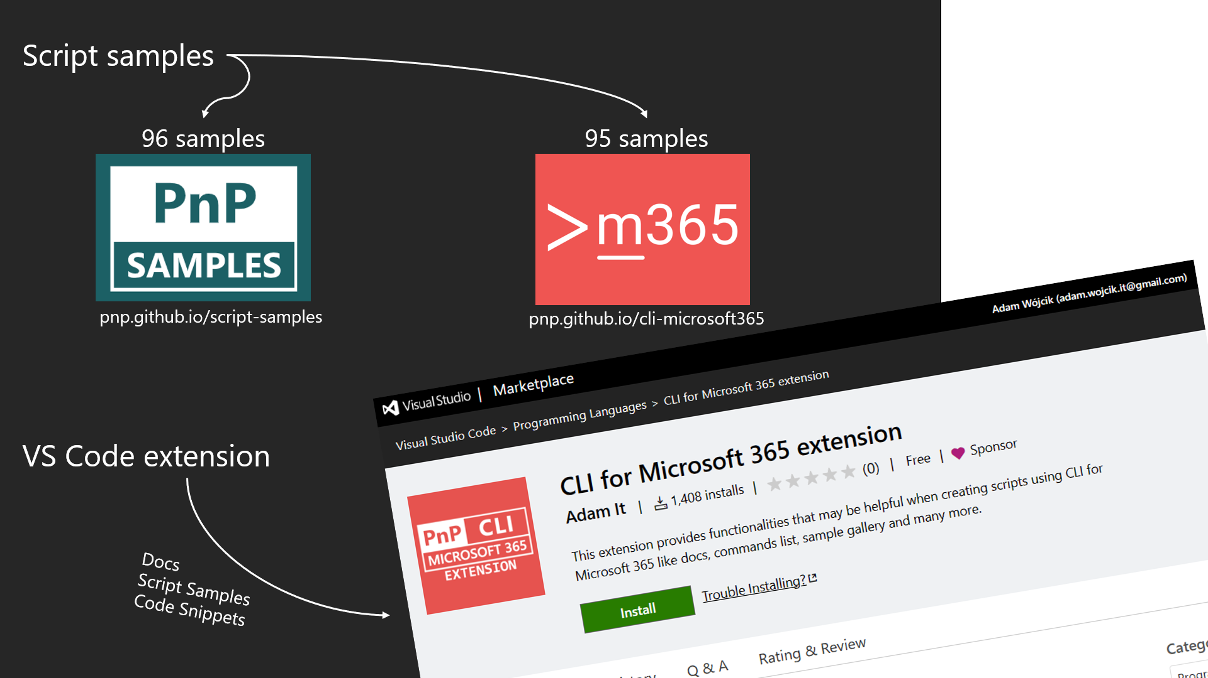
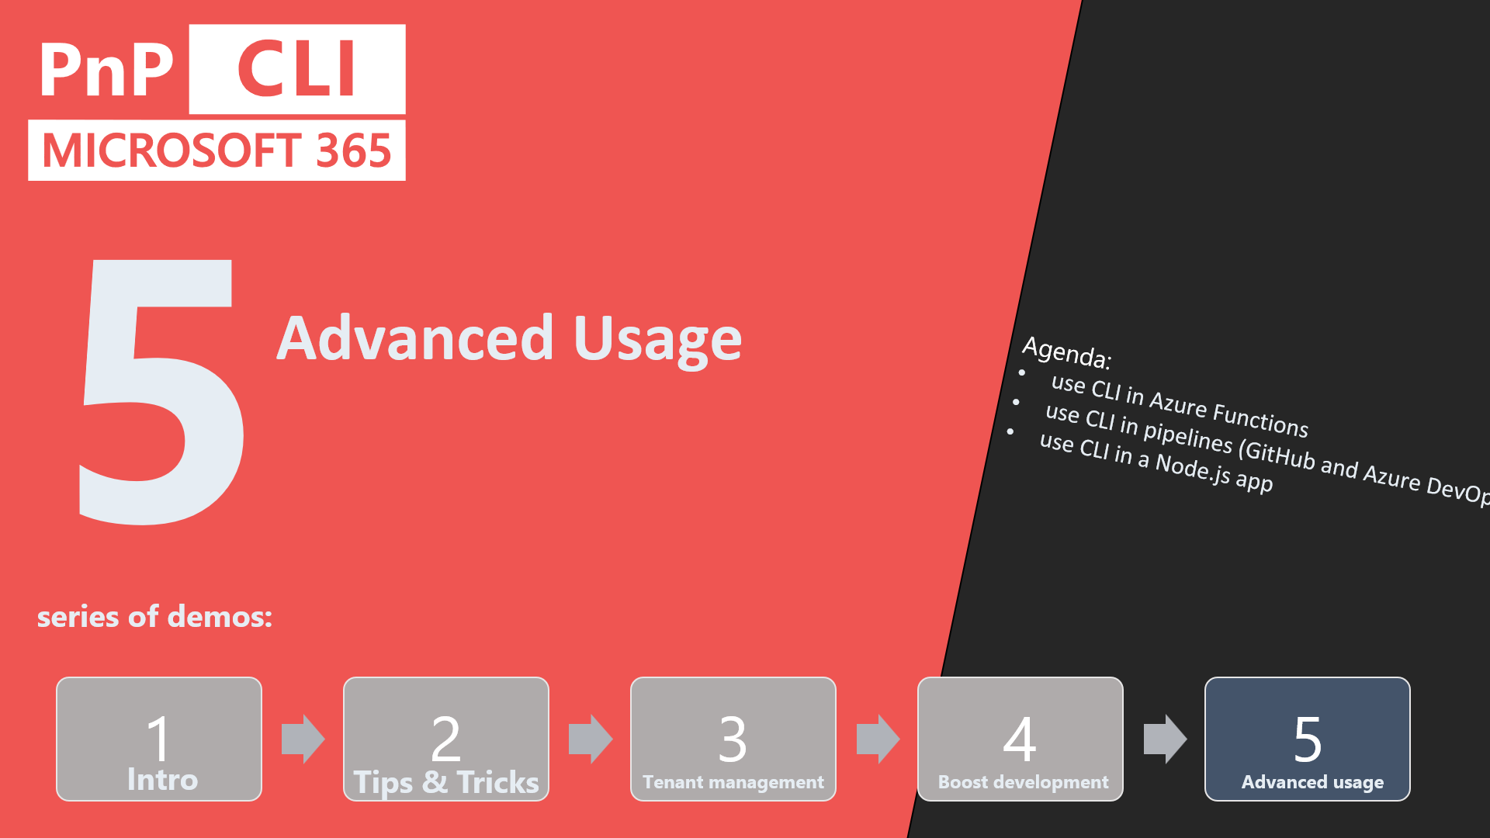
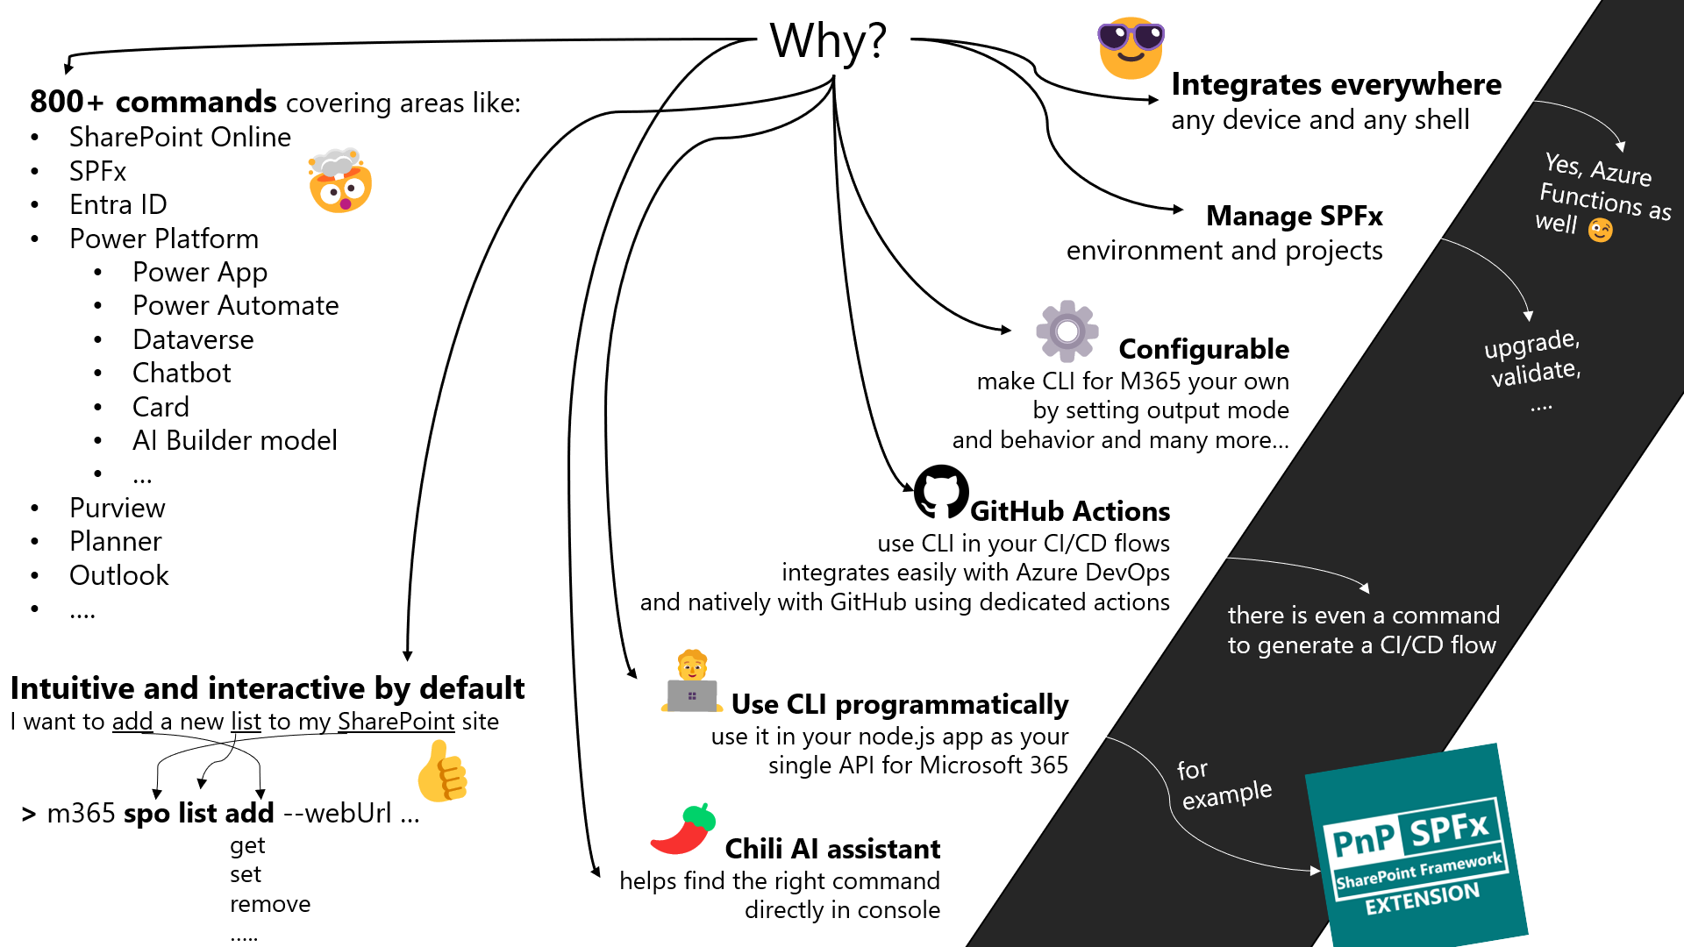
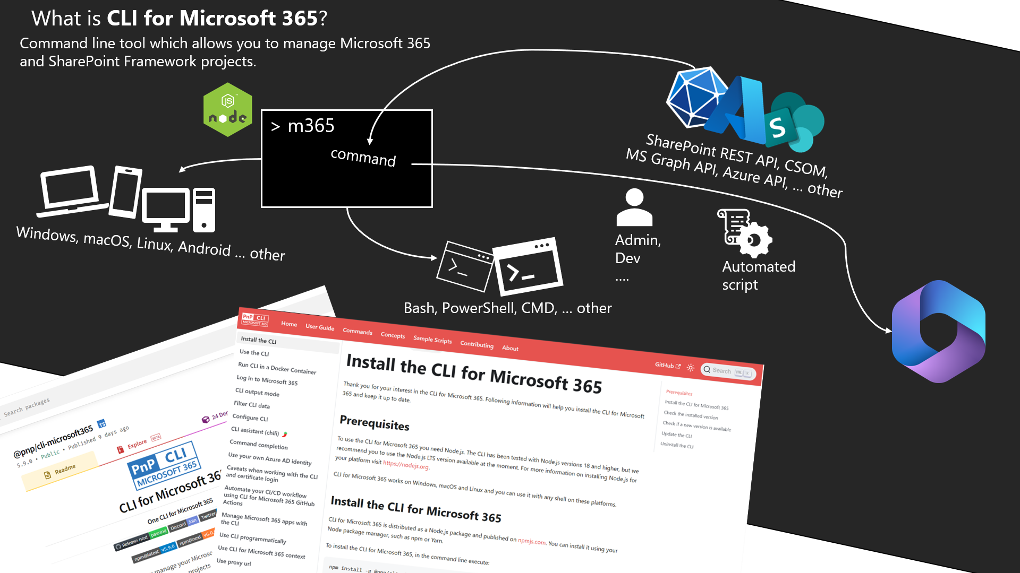
🍿 DEMO
SERIES about CLI for MICROSOFT 365
🤩
Save the dates:
📅
1 - 22.02
2 - 07.03
3 - 21.03
4 - 04.04
5 - 18.04
🚀

Slide 2

5
Advanced Usage
1
2
3
5
4
Agenda:
use CLI in pipelines (GitHub and Azure DevOps)
use CLI in a Node.js app
use CLI in Azure Functions
series of demos:
Intro
Tips & Tricks
Tenant management
Boost development
Advanced usage

Slide 3

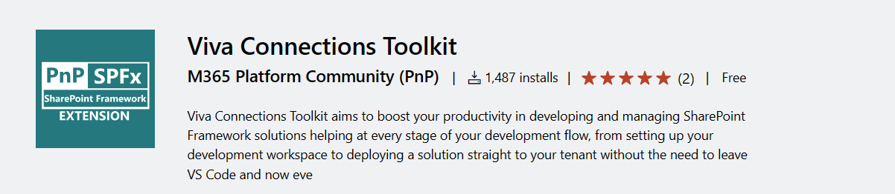
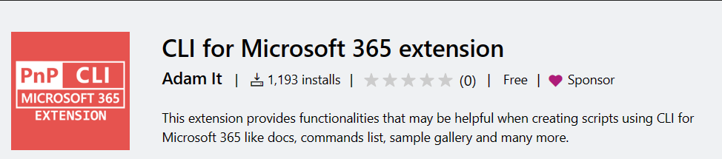
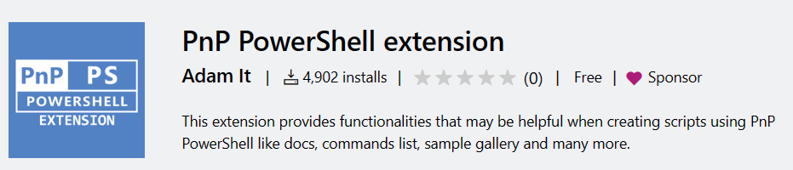
typeof(me);
new PnPTeamMember
{
Name = "Adam Wójcik",
Description = @"Father🍼 & Standard dev that loves coding with headphones🎧 on
and coffee☕ next to the keyboard👨‍💻",
Position = ".NET/FullStack/SharePoint/Microsoft 365 Developer/Consultant 🤔",
Other = ["PnP Core Team member",
"CLI for Microsoft 365 maintainer 🤩",
"SharePoint Framework Toolkit maintainer",
"PnP PowerShell extension maintainer",
"CLI for Microsoft 365 extension maintainer",
"MVP"],
Employer = "Hitachi Energy",
Location = Country.Poland,
Social = new List<SocialType>()
{
SocialType.LinkedIn,
SocialType.X
SocialType.Discord 🤩
}
};

Slide 4
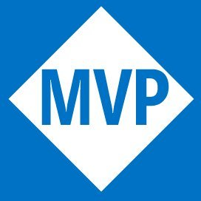





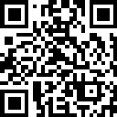


Microsoft MVP (M365 Development)
Co-maintainer – CLI for Microsoft 365
Team Member – Microsoft 365
& Power Platform Community (PnP)
Solution Architect with TCS
Arjun Menon
/in/
arjunumenon
arjunumenon.com
Notes:
Talk about David and Hugo PnP Sharing is Caring Alumni

Slide 5

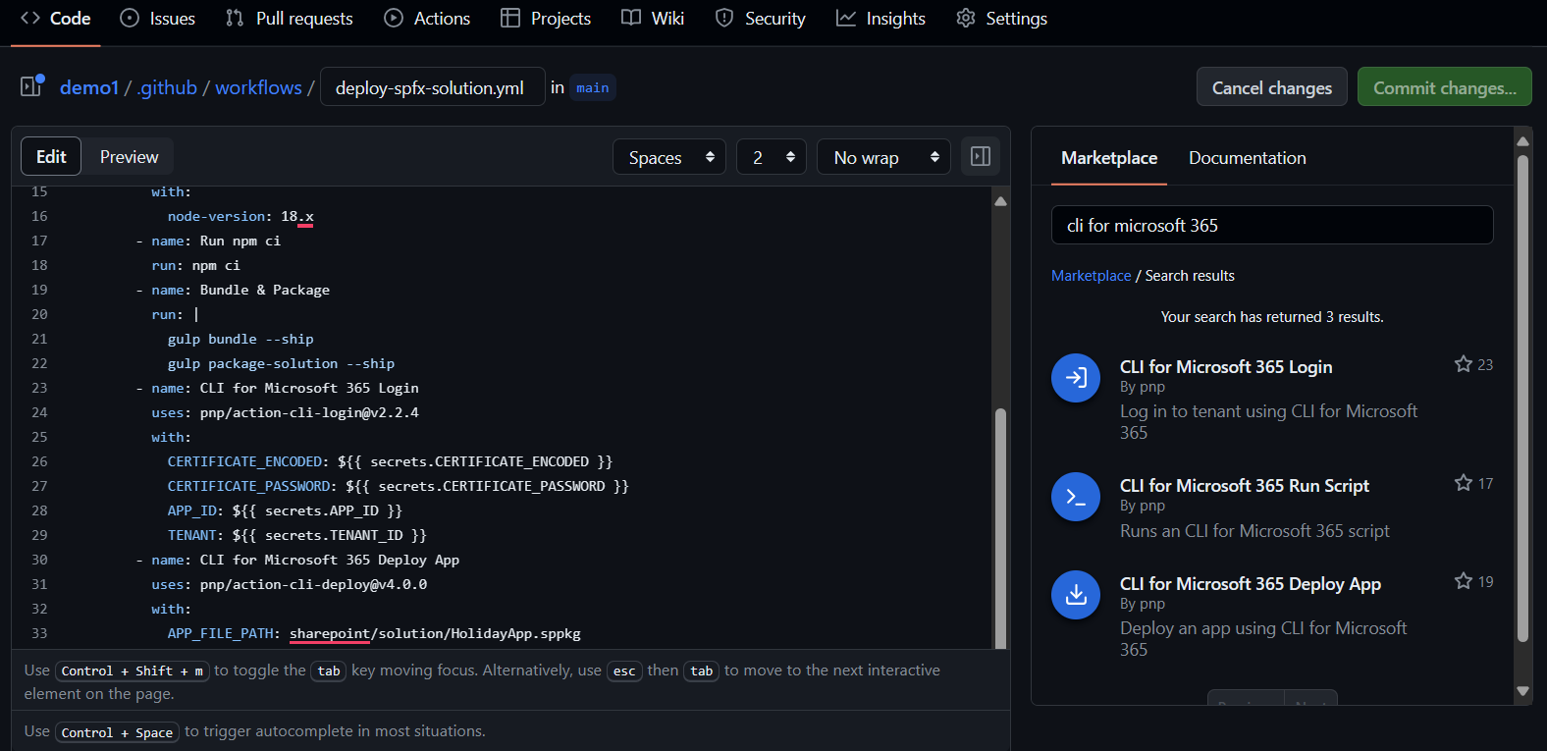
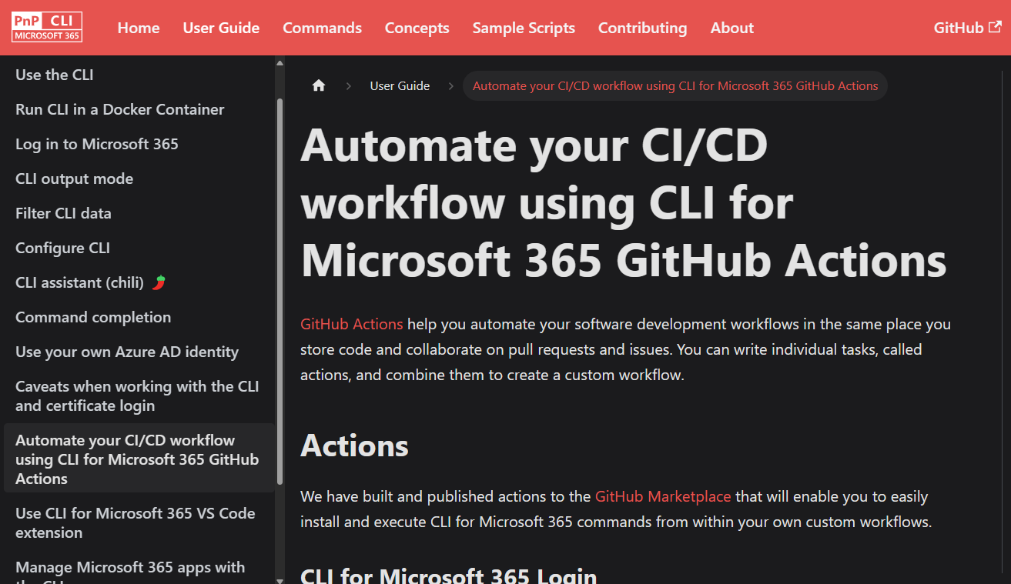
Use CLI for Microsoft 365 in GitHub workflows
GitHub
Actions

Slide 6
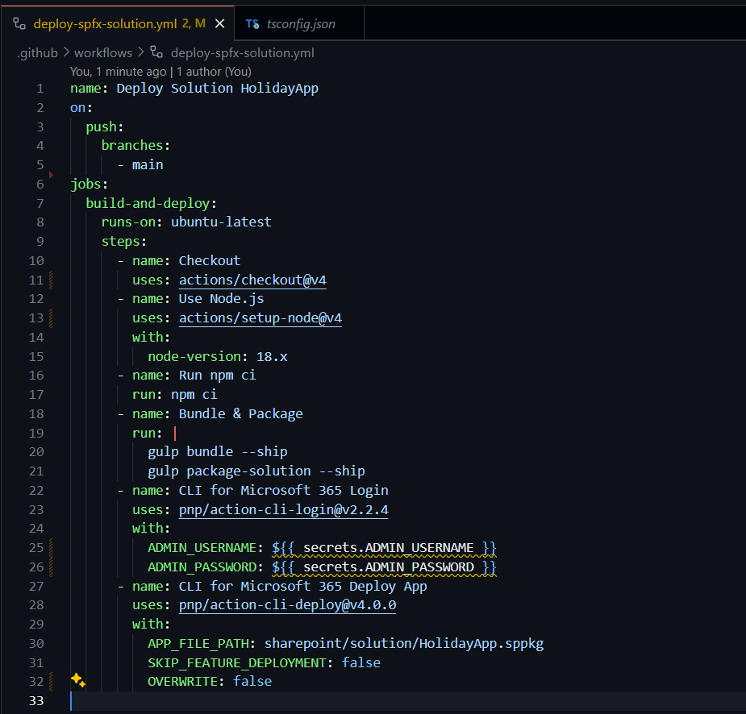
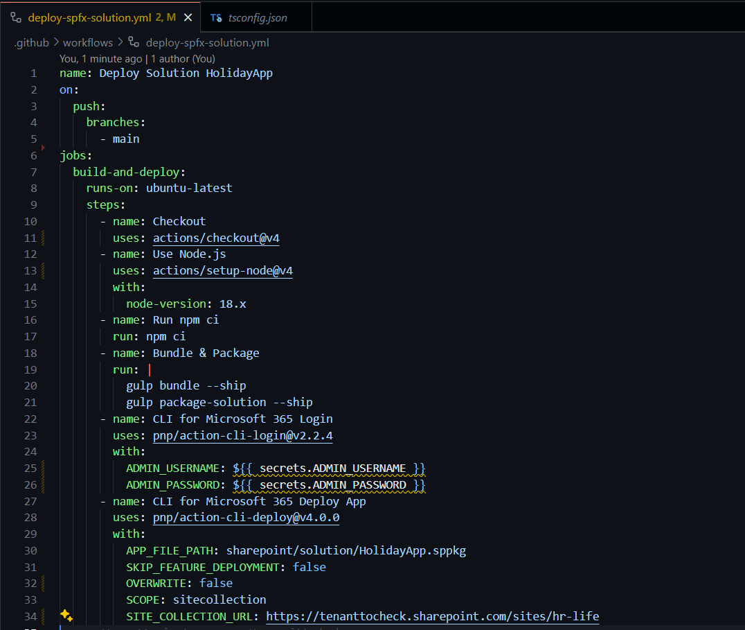
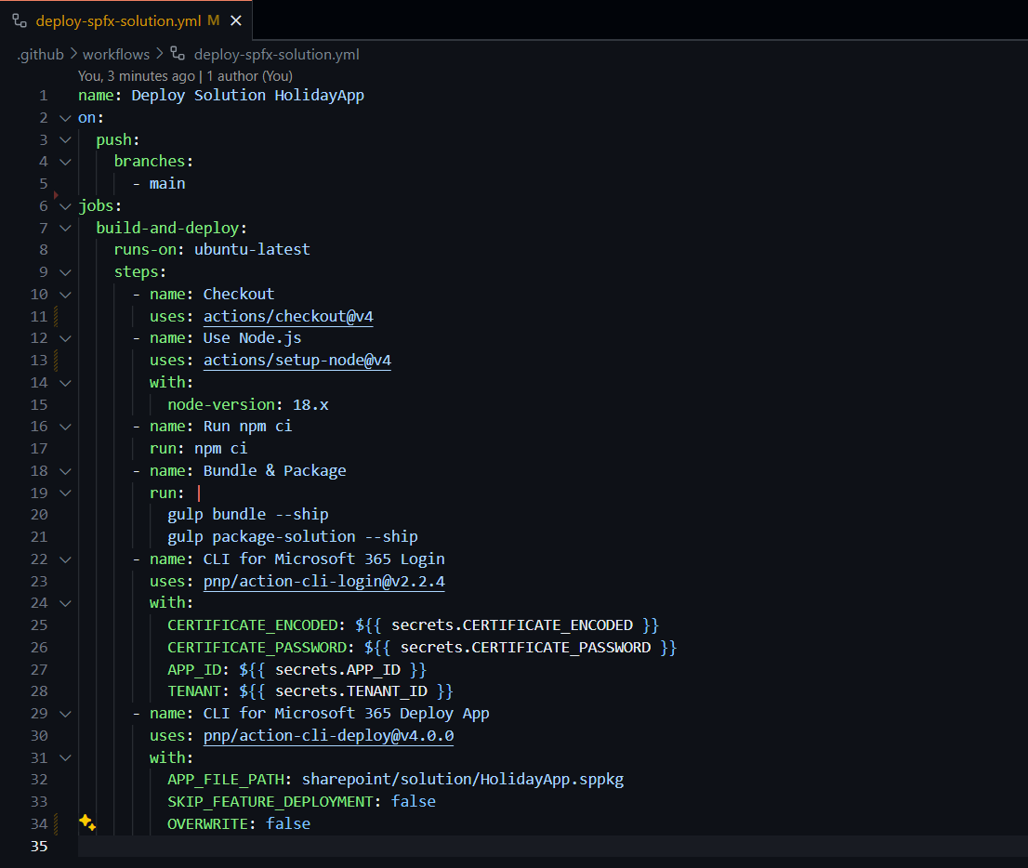
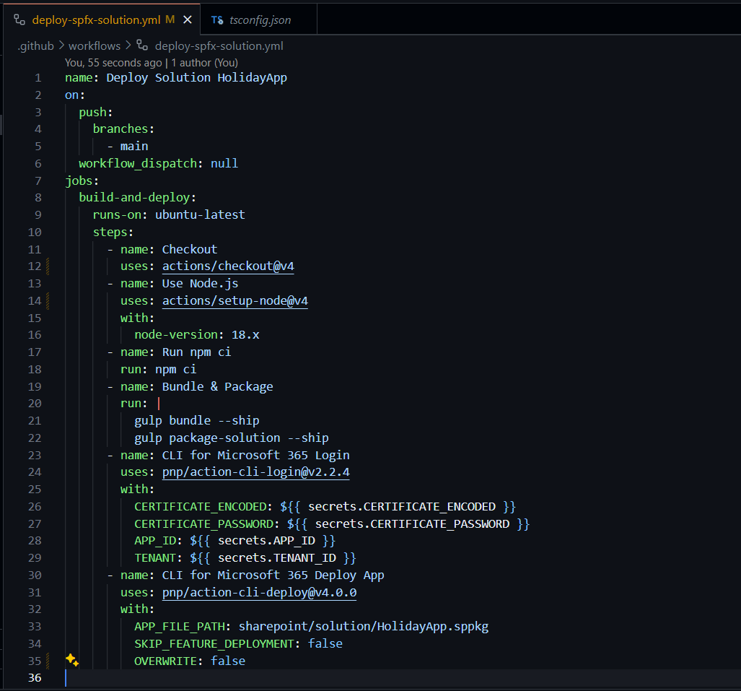
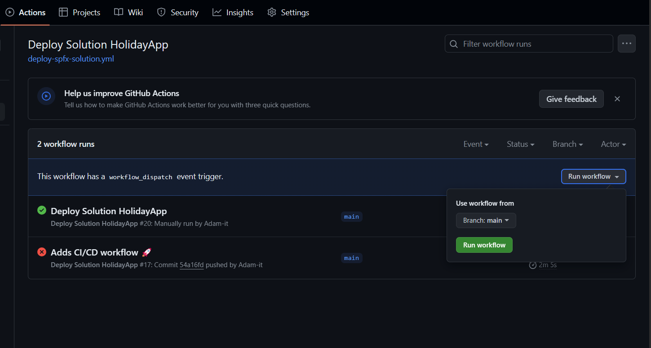
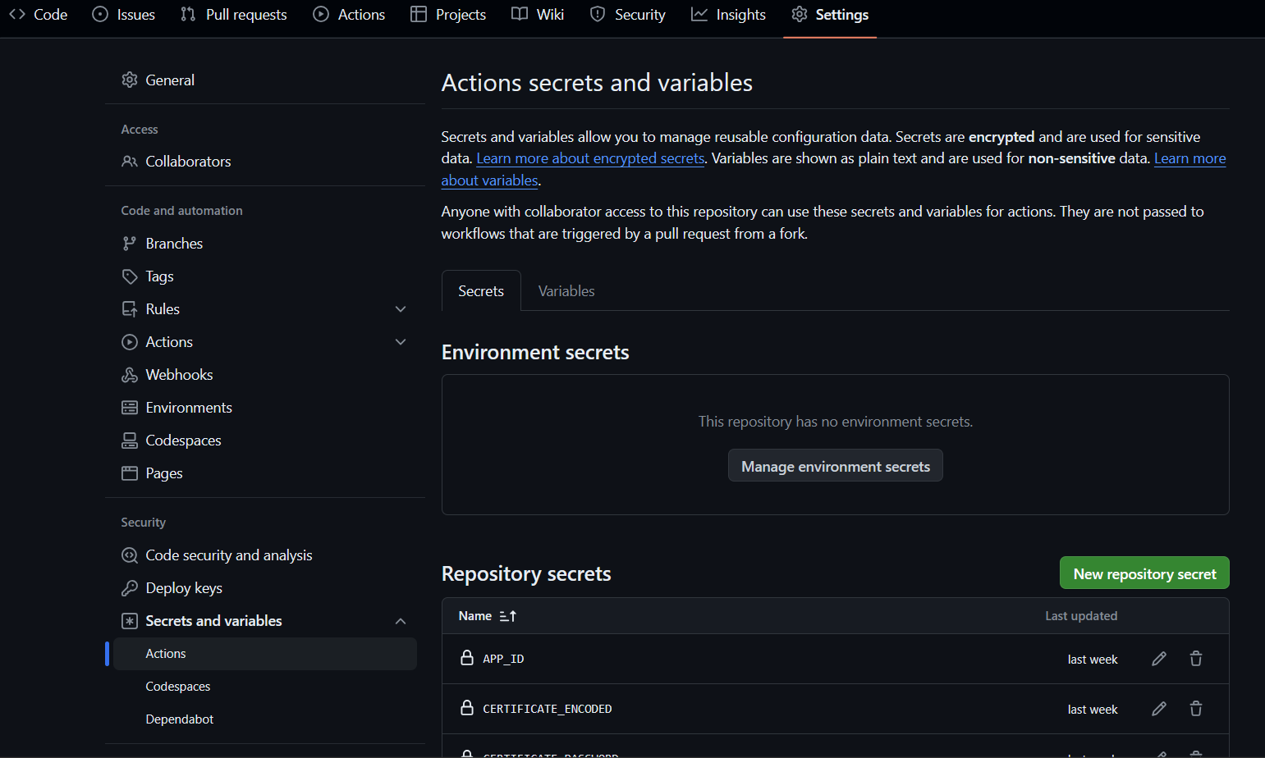
Generate GitHub workflow for your SPFx project in seconds
run in context of project
> m365 spfx project github workflow add
--loginMethod user
--scope sitecollection --siteUrl https:/...
--manuallyTrigger

Slide 7
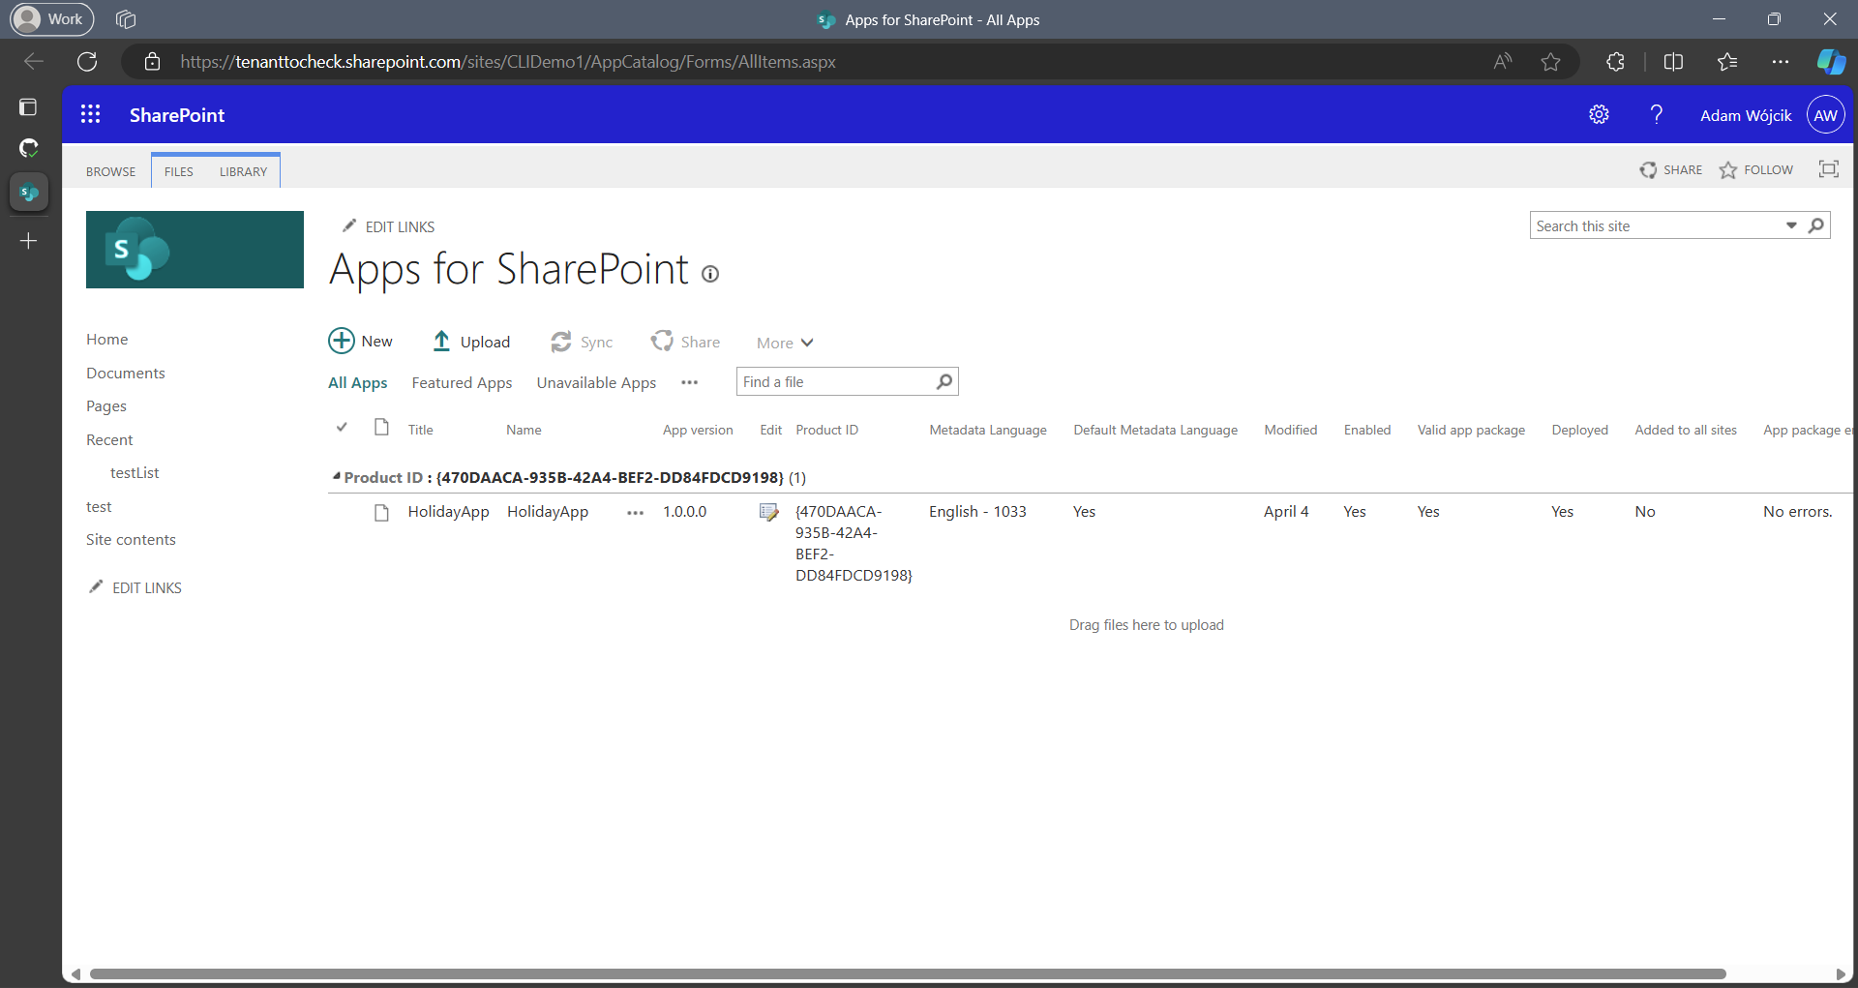
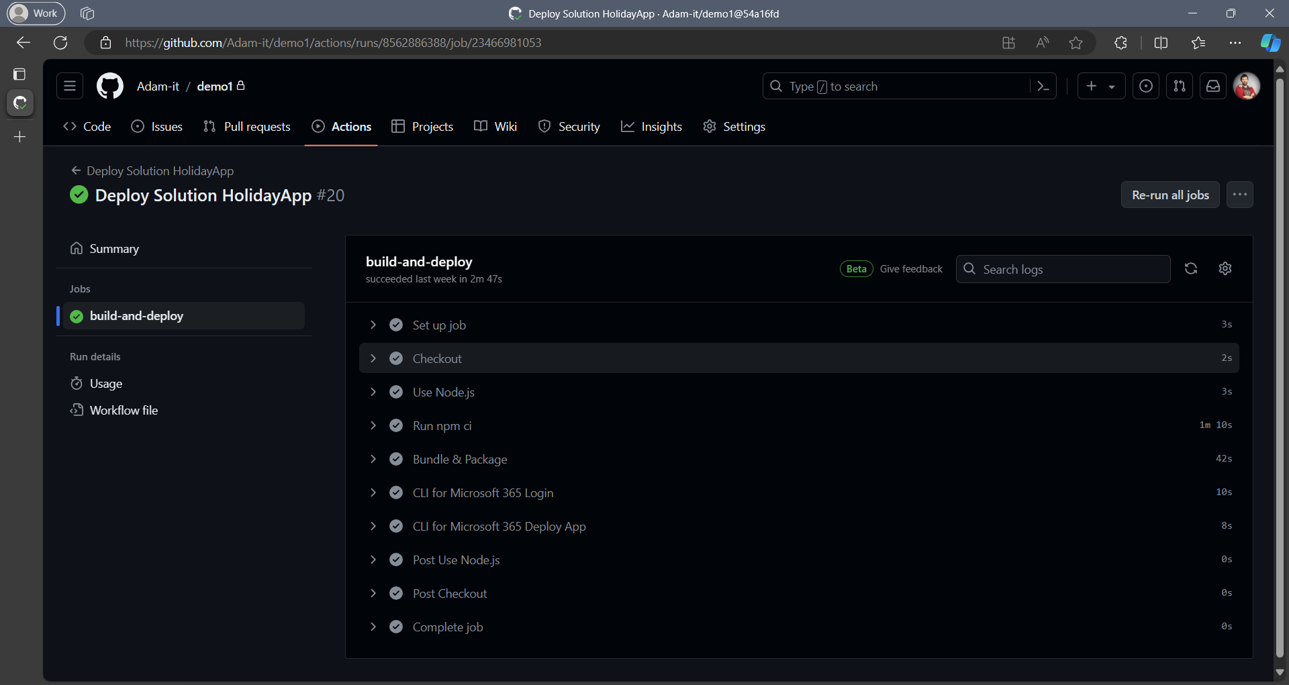
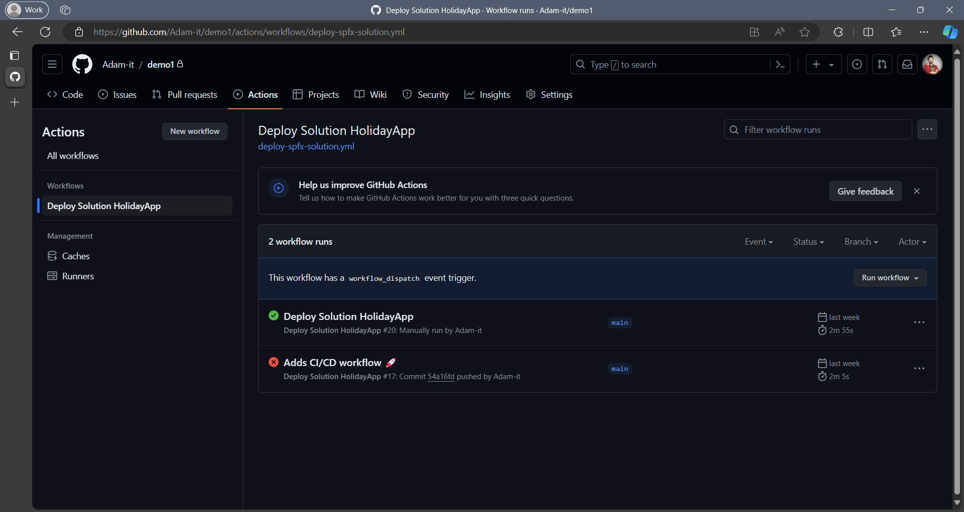
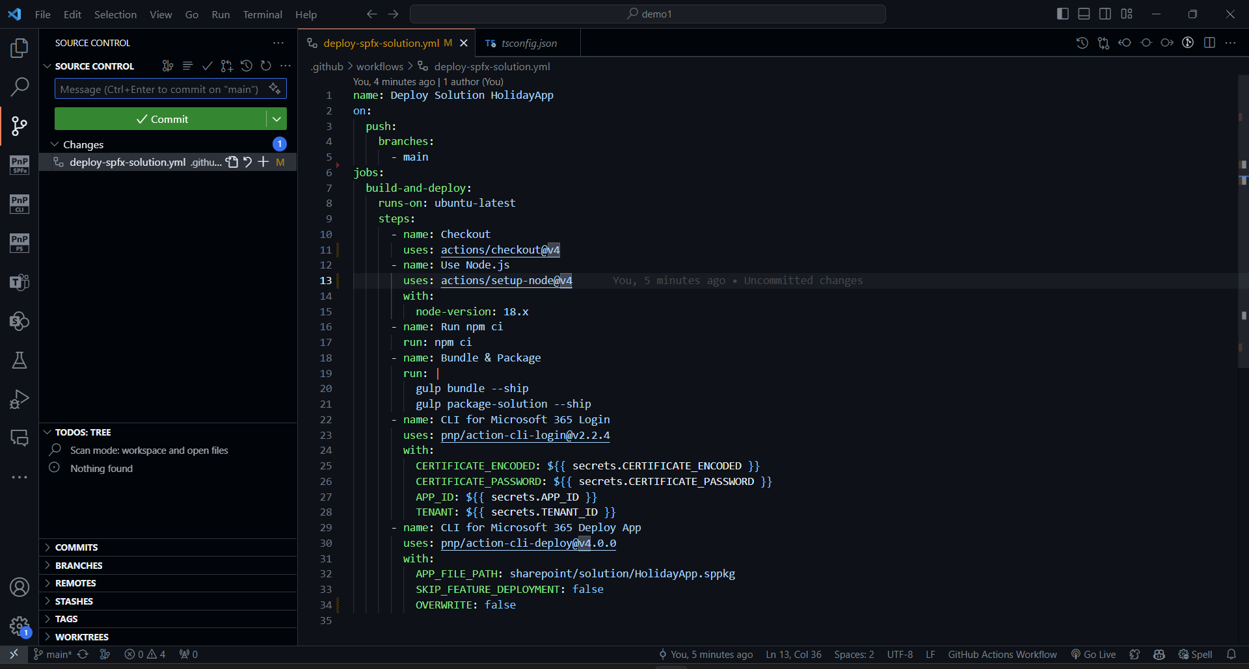
> m365 entra app add
--name 'My CI/CD Application’
--apisApplication 'https://microsoft.sharepoint-df.com/Sites.FullControl.All’
--certificateFile ./CI-CD-Certificate.cer --certificateDisplayName 'CICD Certificate’
--grantAdminConsent

Slide 8
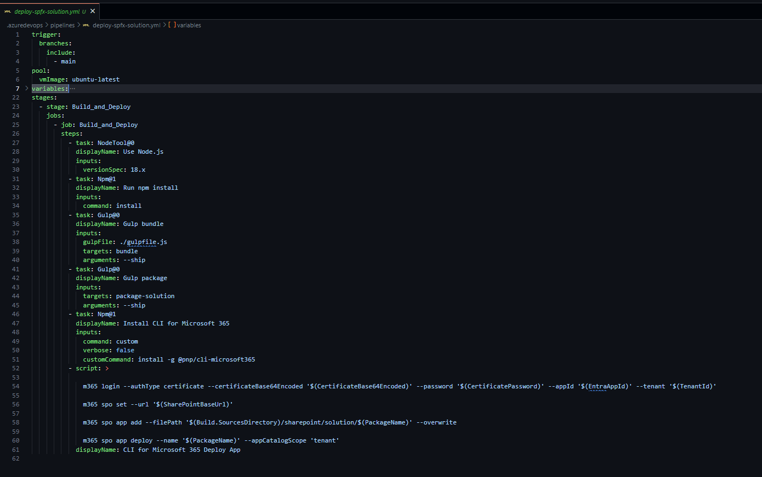
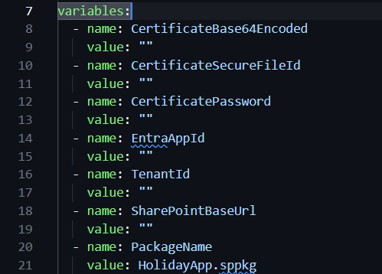
Generate Azure DevOps Pipeline
for your SPFx project in seconds
> m365 spfx project azuredevops pipeline add
--name
--branchName
--loginMethod
--scope
--skipFeatureDeployment
--manuallyTrigger

Slide 9
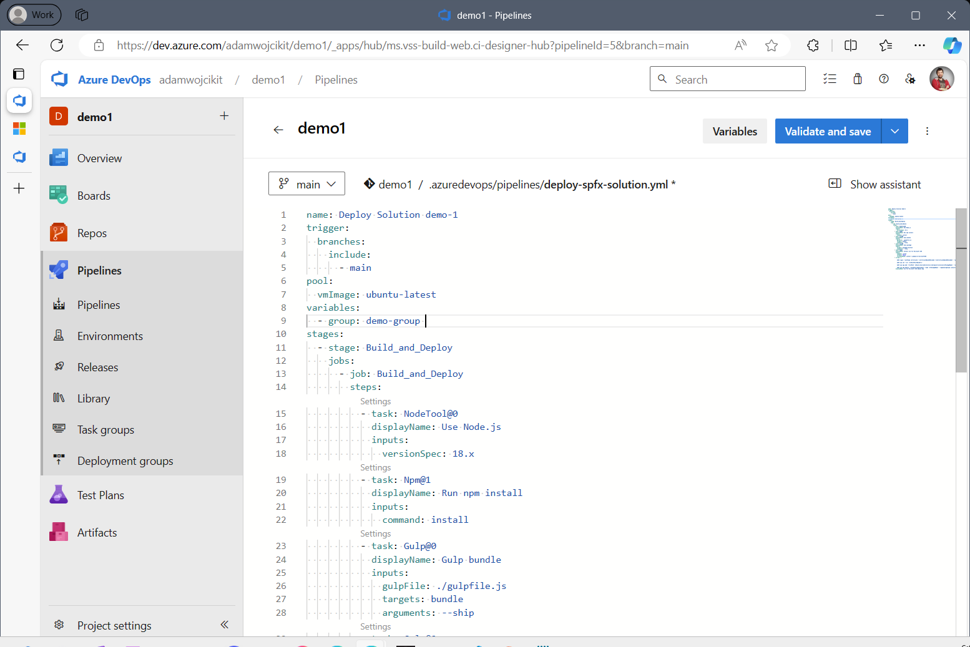
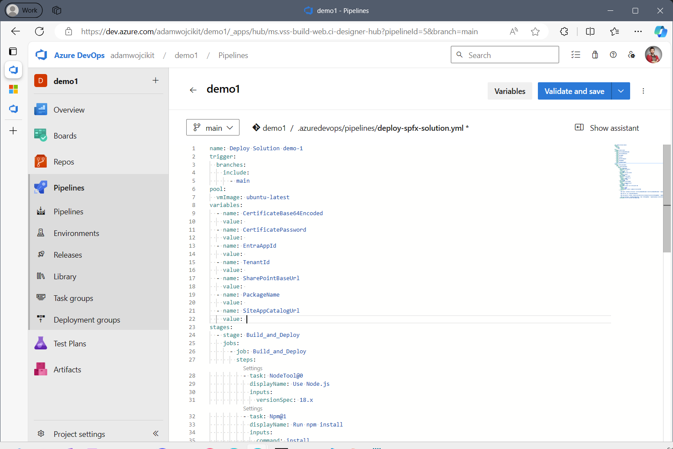
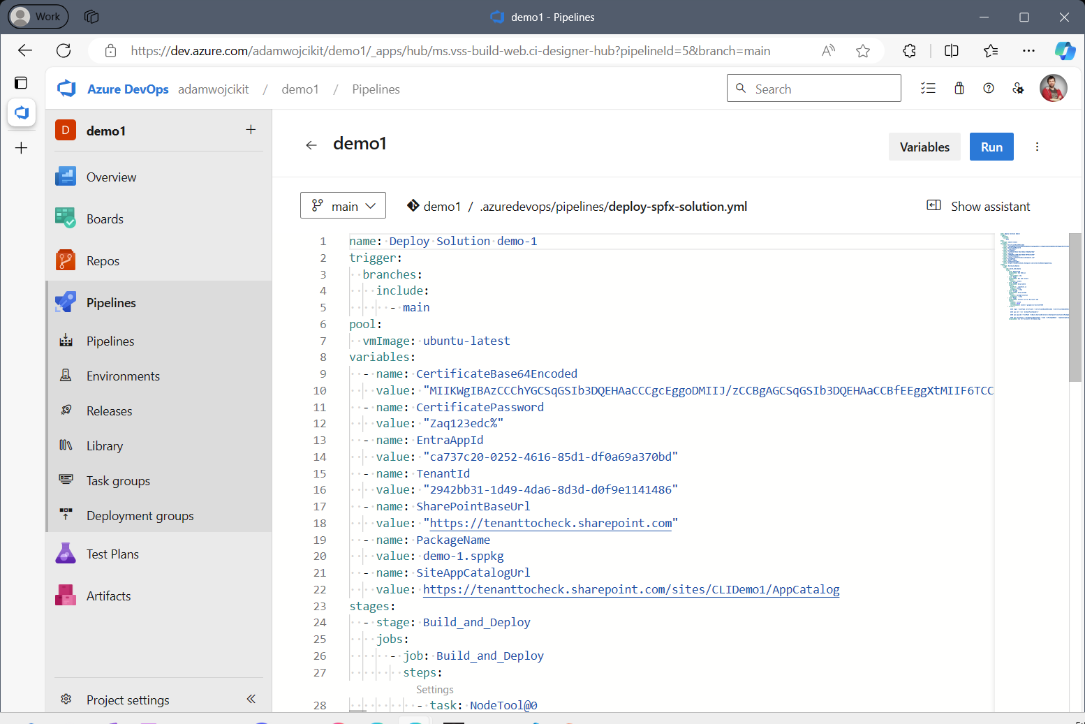
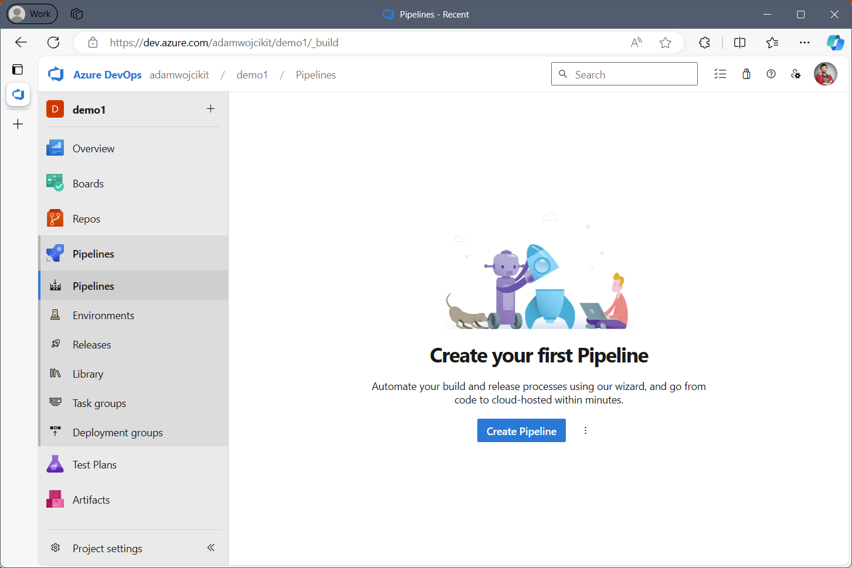
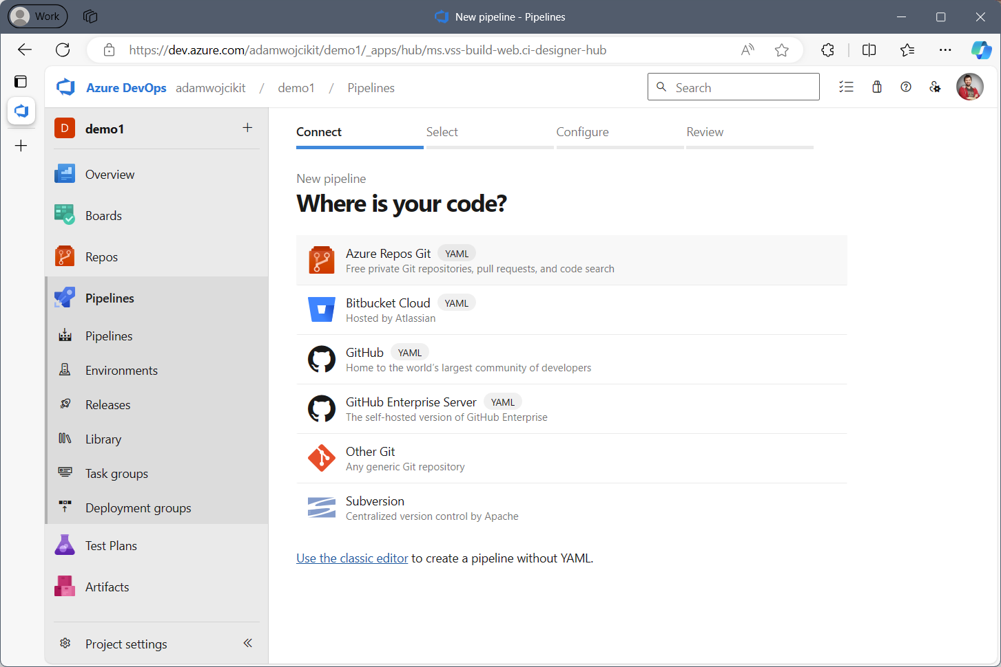
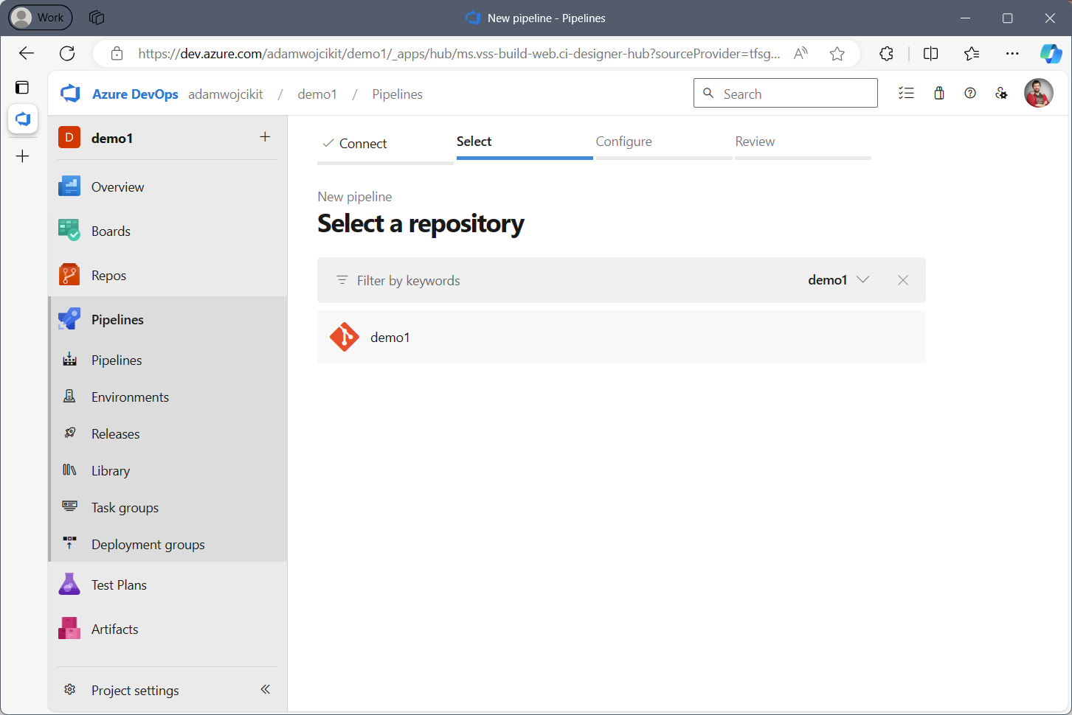
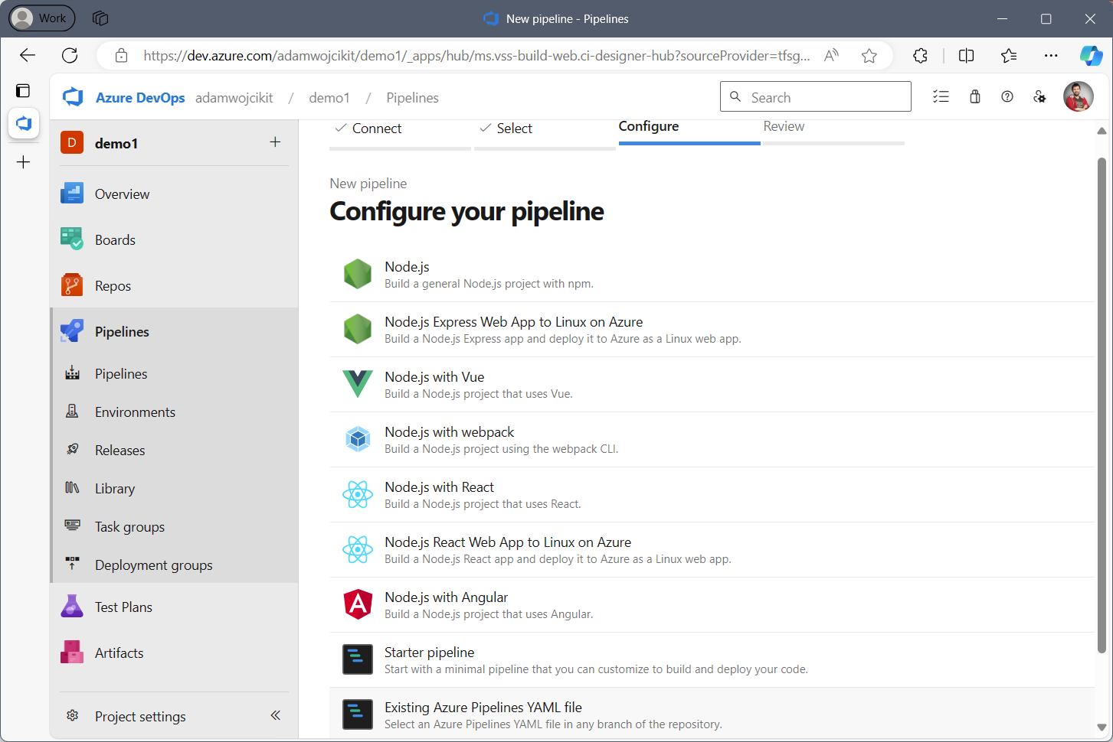
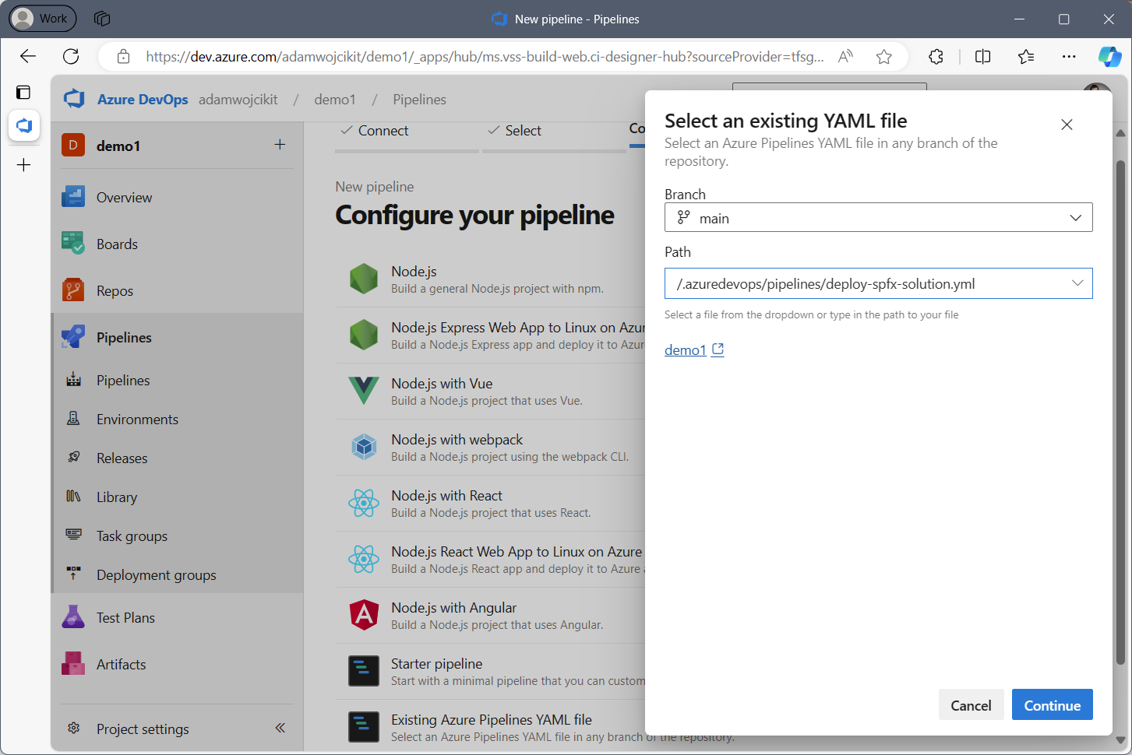
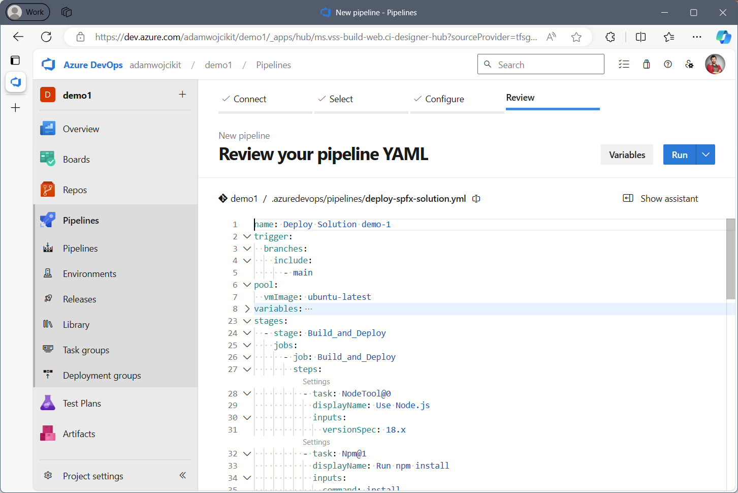
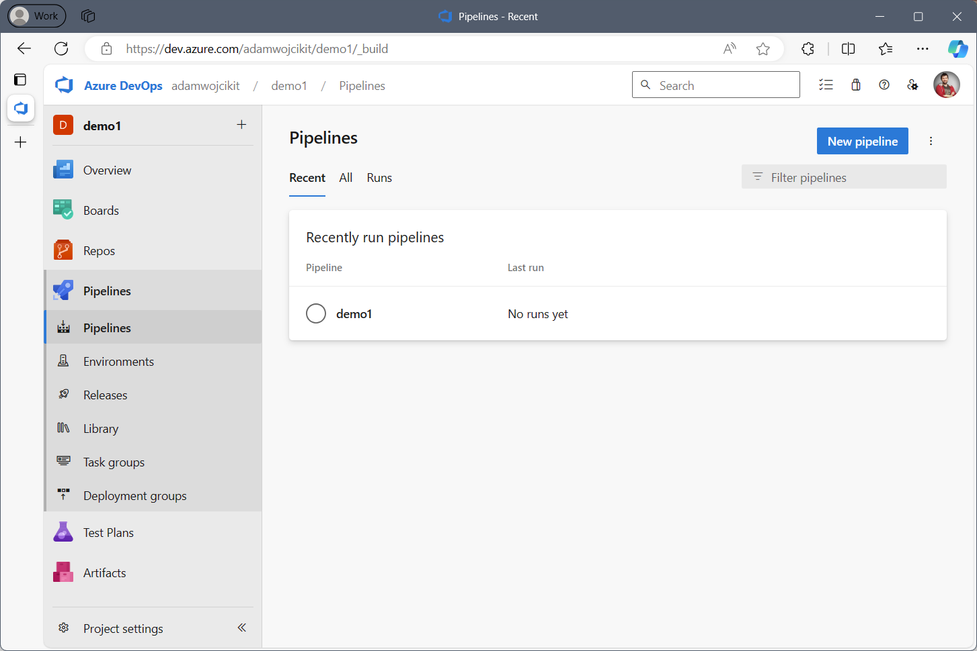
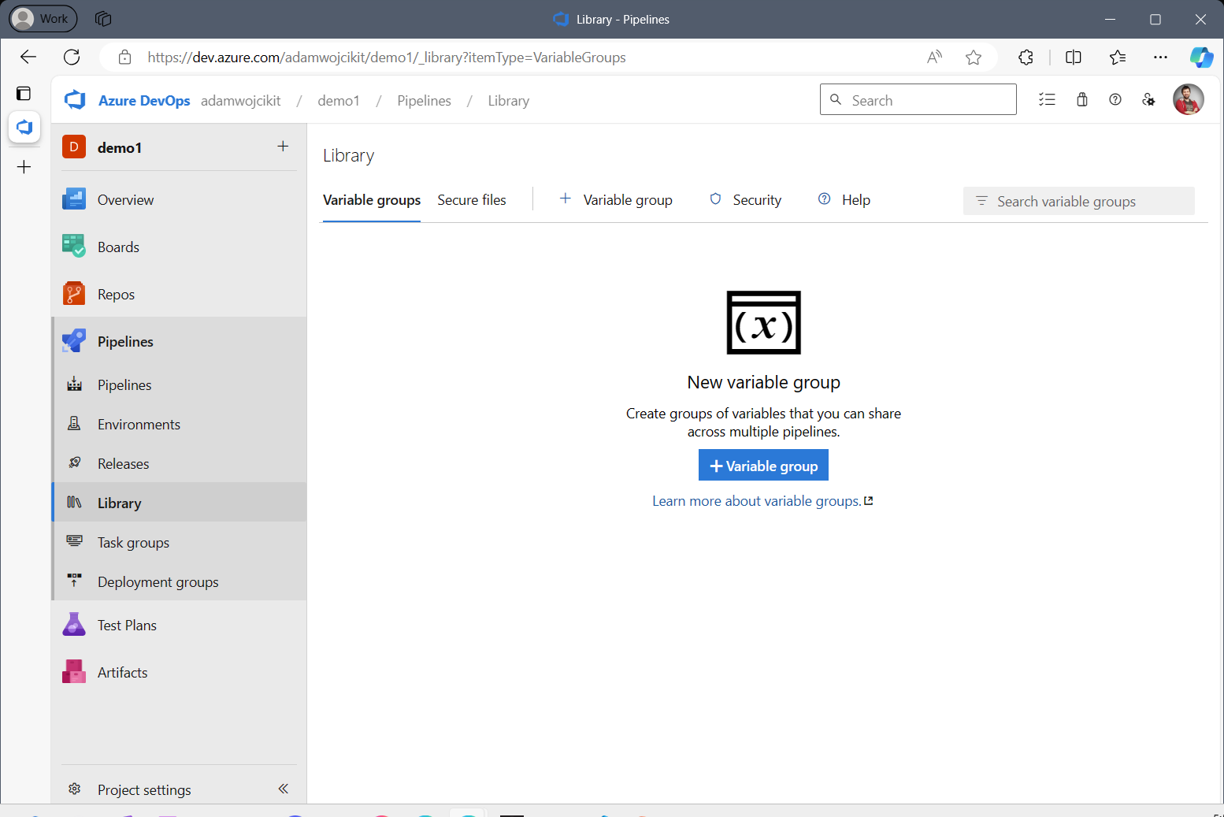
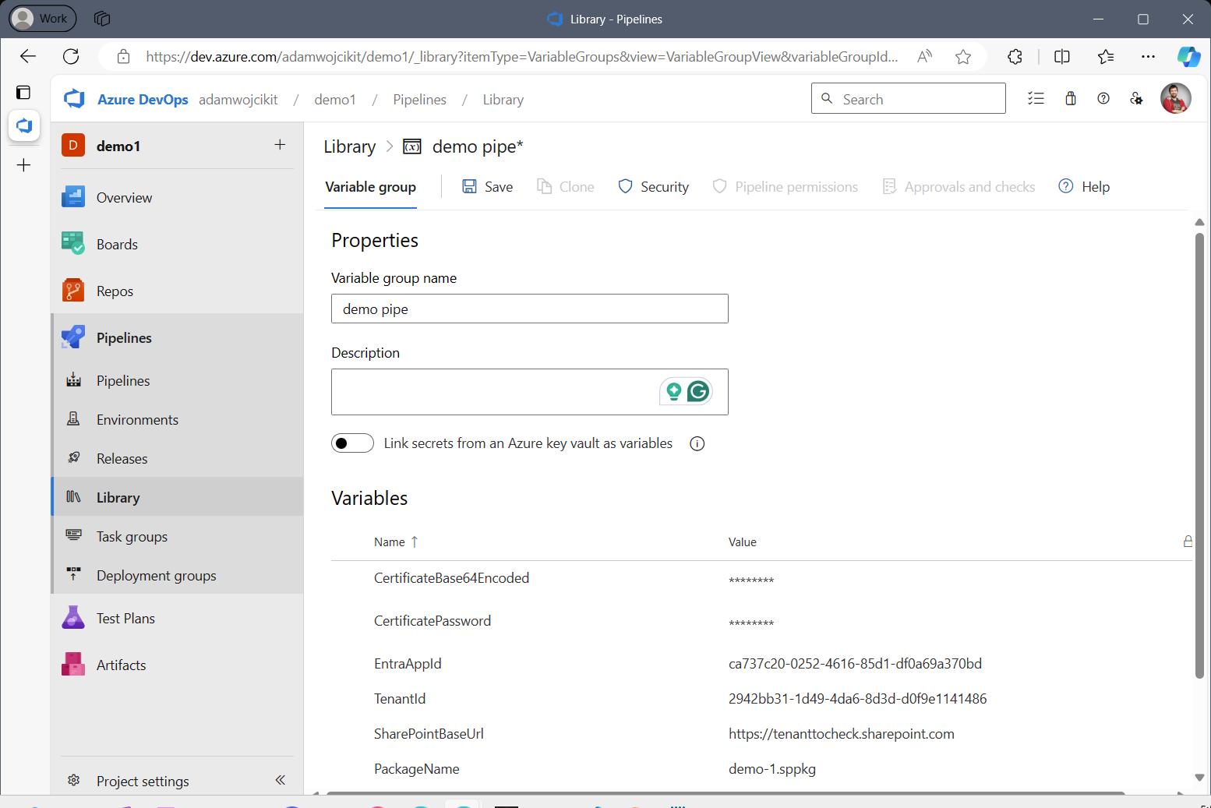
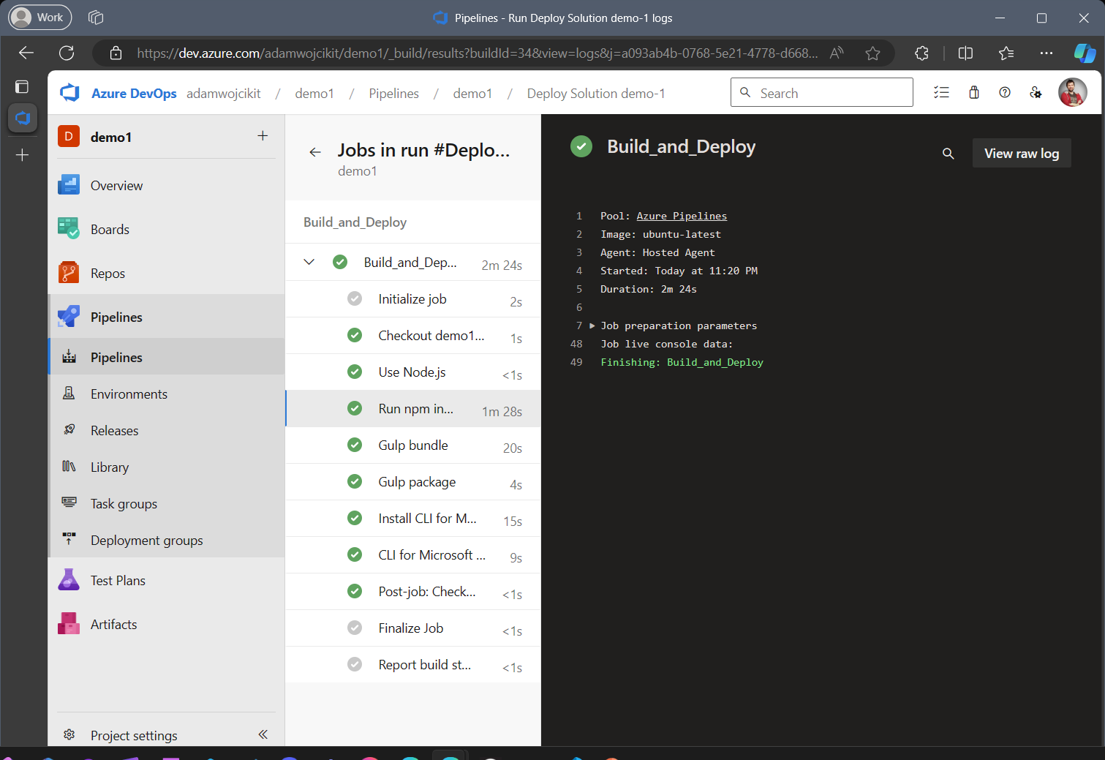
v
❌
✅
🫣
🤩

Slide 10
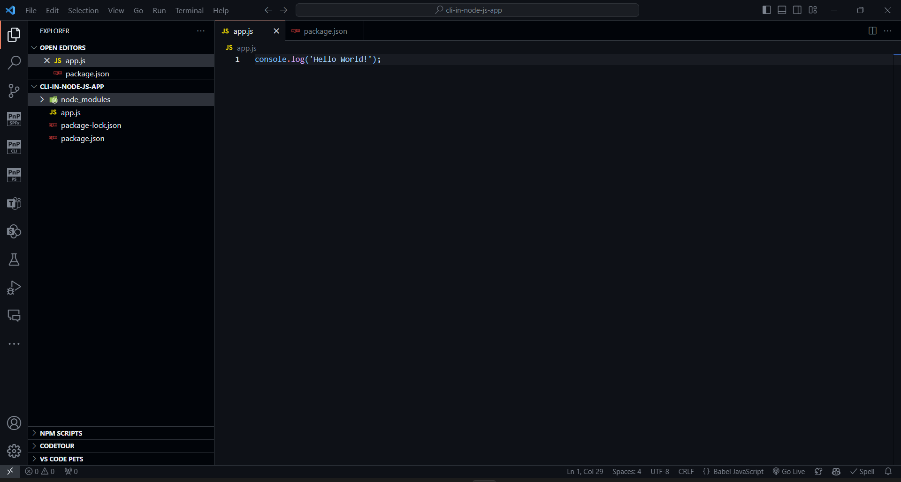
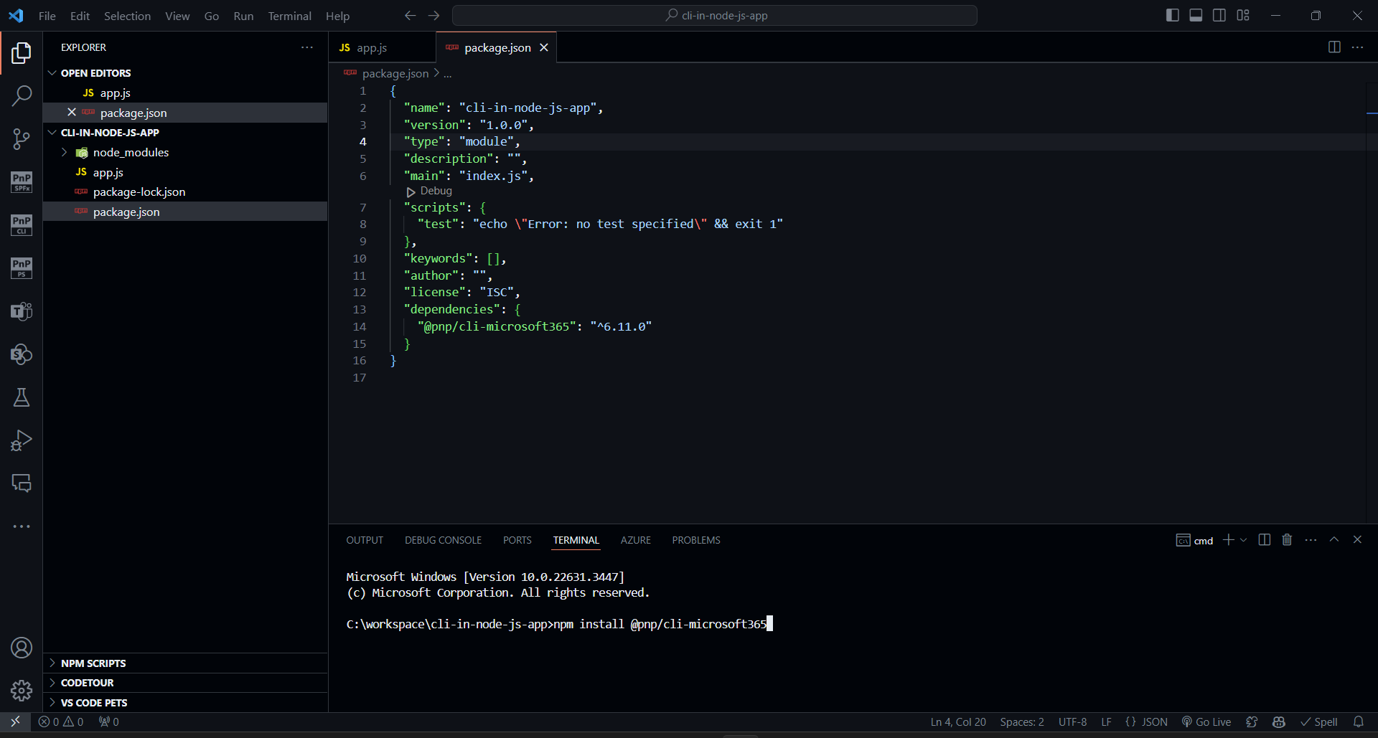
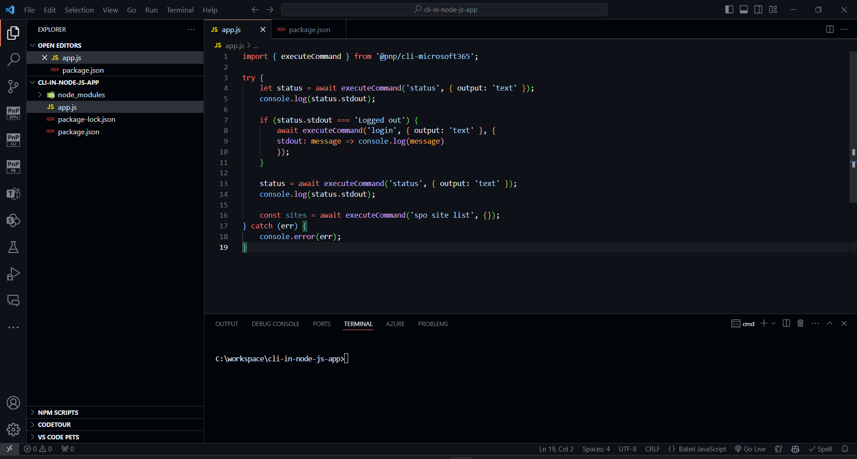
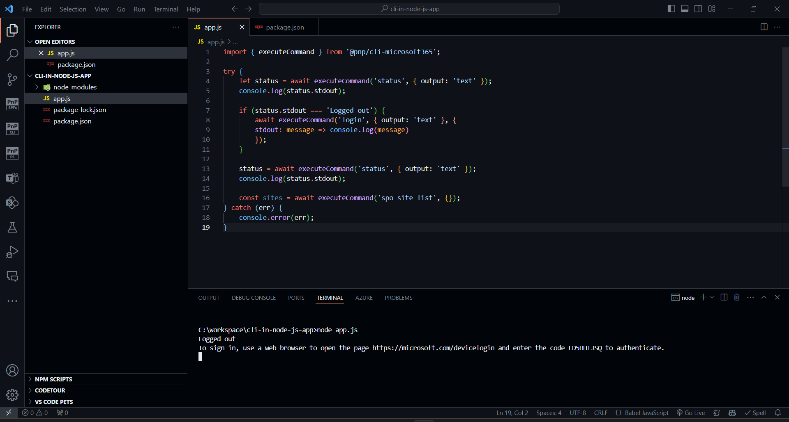
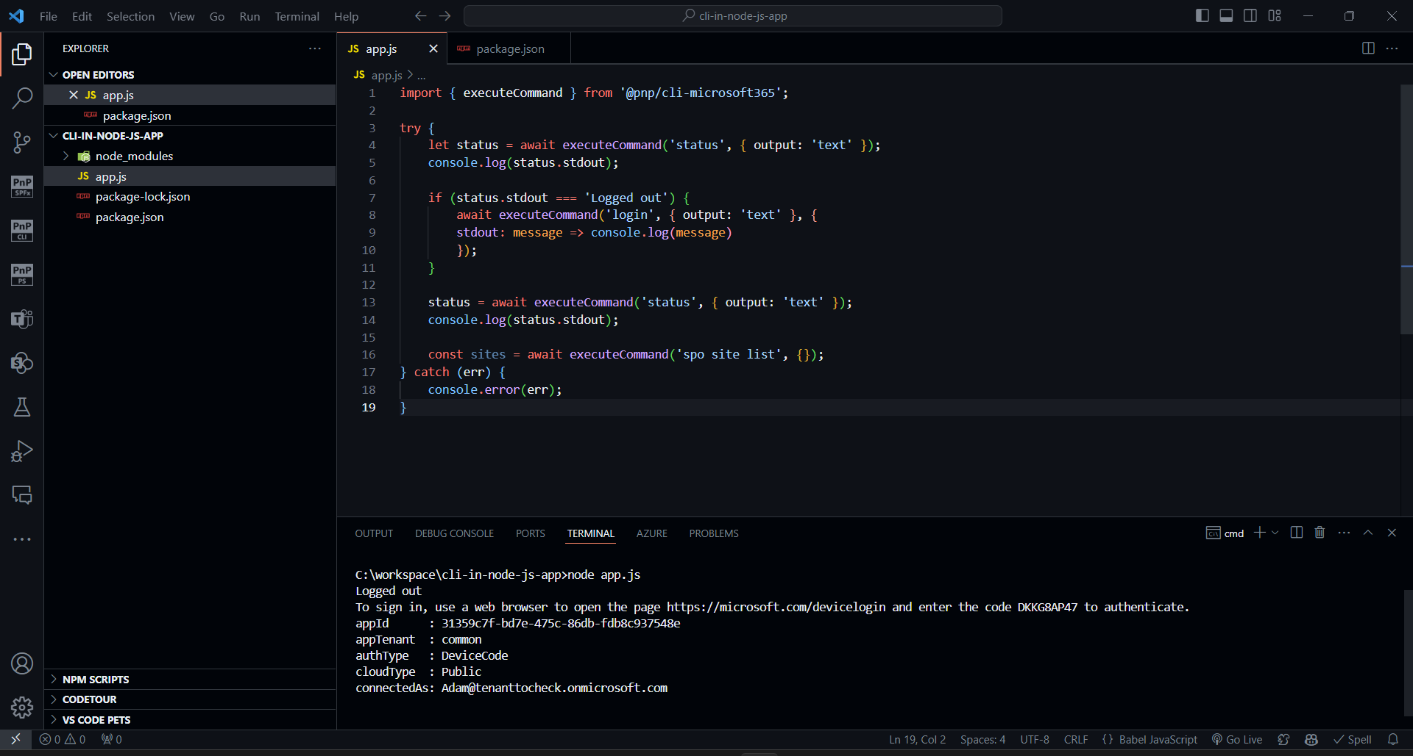
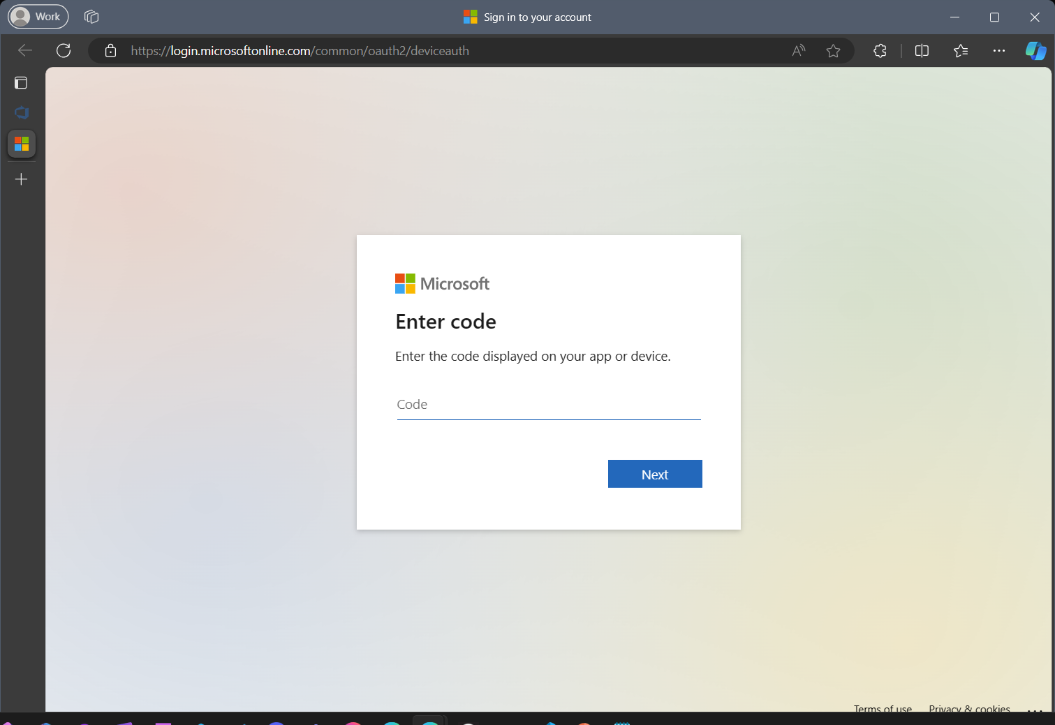

Use CLI for Microsoft 365 in your app

Slide 11
CLI for Microsoft 365 in Azure Function
Why do you need it 🤔 ?
Easily port your business logic for existing scripts
No need to reinvent the wheel
Easily build your backend logic with your command line building knowledge
Build in your favorite language (JavaScript / TypeScript)

Slide 12

See it in Action 🎦
Teams Bot
Azure Function
Back end in CLI for Microsoft 365

Slide 13





Thank You 👋
👇
Join our Discord server and let's stay connected
Office hours at last Monday of every month
🤩
End of series 😢
📄
Be sure to check our docs to find out more
https://aka.ms/cli-m365
🐦
Follow us on X @climicrosoft365
https://discord.com/invite/Wtz6BTVX5H

